Slide 1
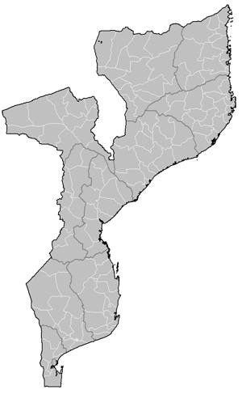
MOZAMBIQUE
Pemba
Palma (Quitunda)
Mueda
Mocimboa
Simone Santi
Mozambique Gas & Energy and Summit and Exhibition 2022
Cabo Delgado province is a subdivision of Mozambique located in the extreme northeast of the country. Its capital is the city of Pemba, located about 2,600 km north of Maputo, the country's capital. The province has an area of ​​82,625 km² and, in 2017, had a population of 2,333,278 inhabitants.

Slide 2
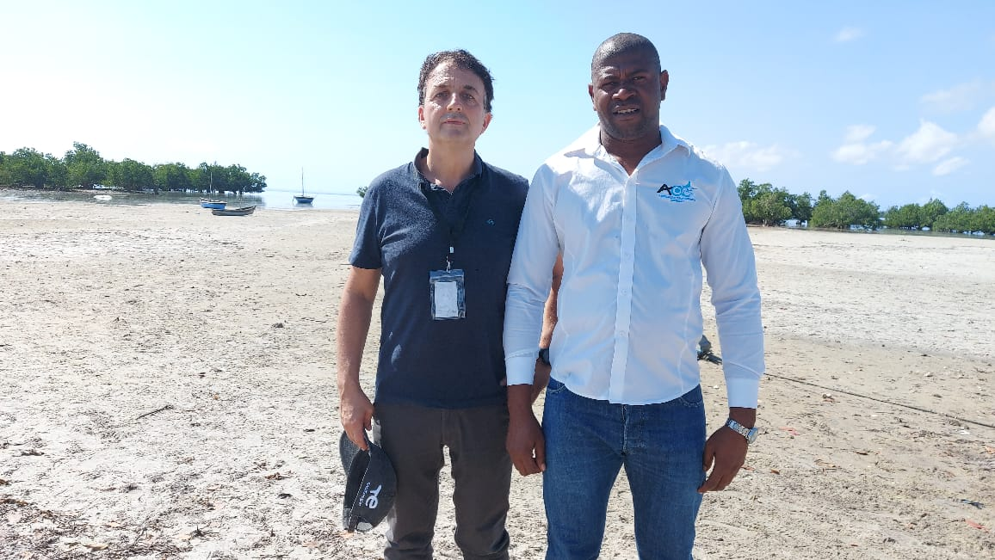
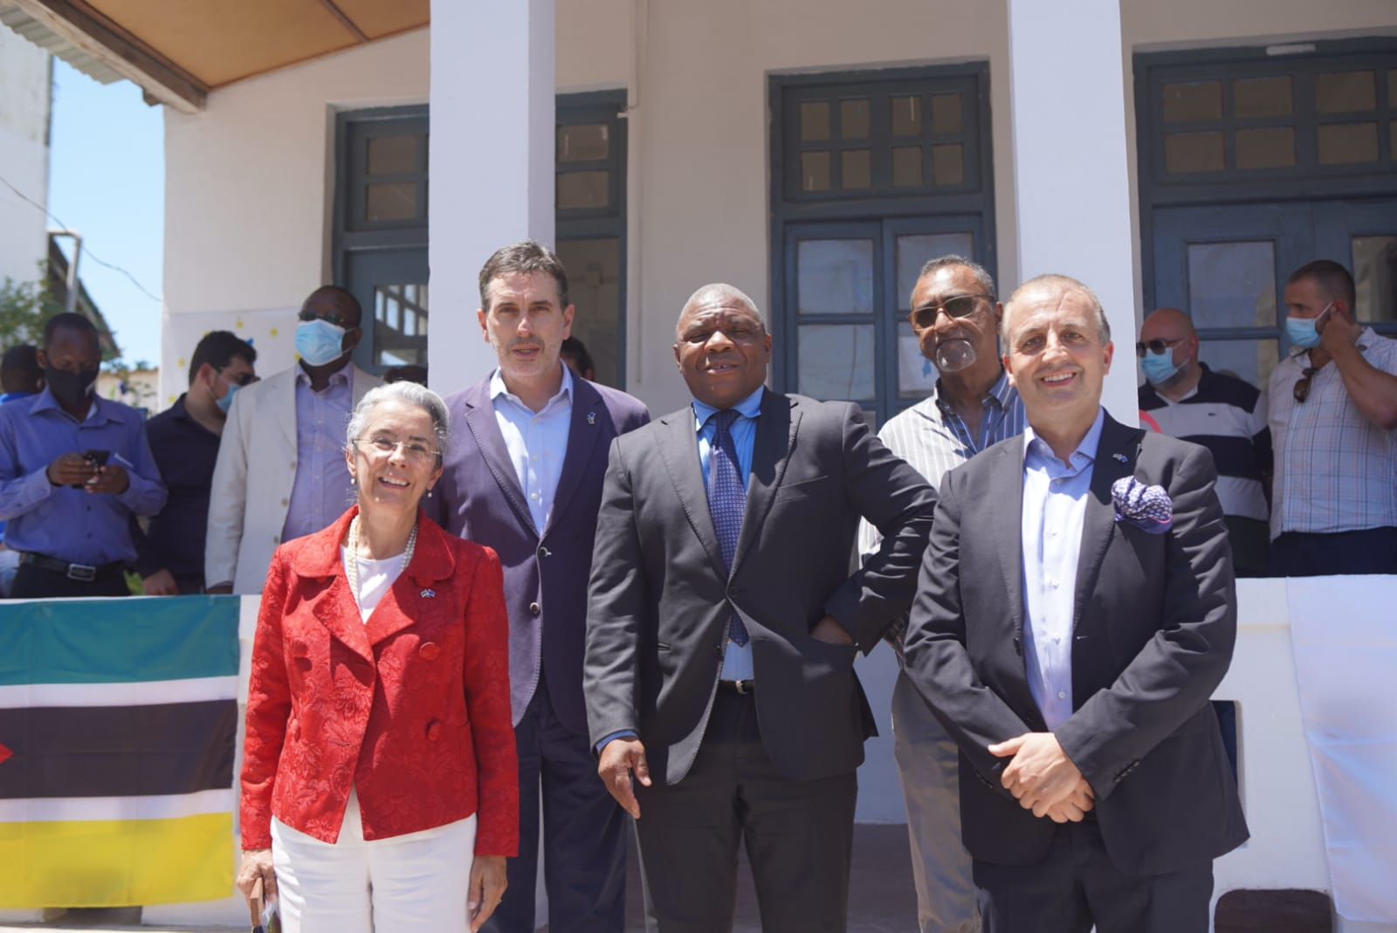
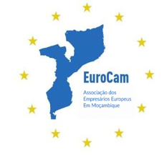
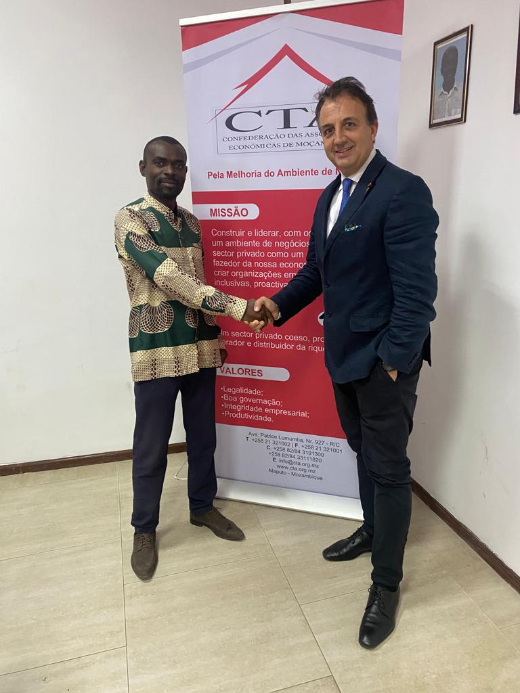
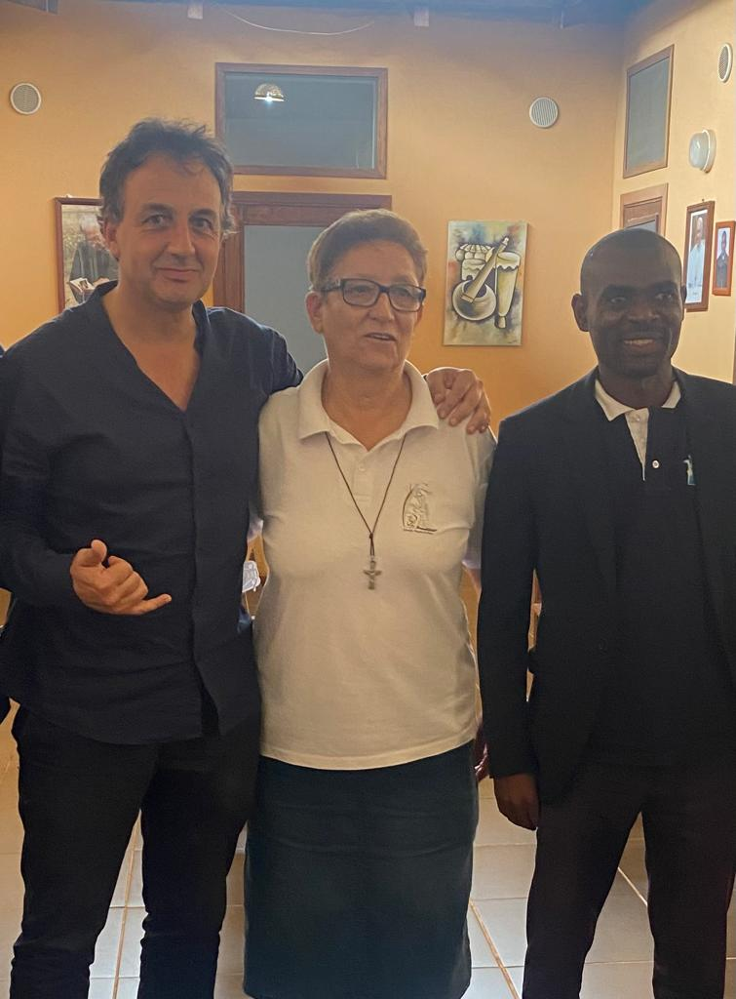
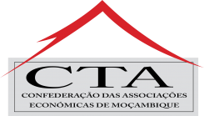
Gallery
1.
2.
3.
1. Visit to Palma 2022
2. Inauguration of the EUROCAM Pemba Office 2020
3. Partnership with
CEP Cabo Delgado 2022
4. Visit to SOS Pemba 2022
4.

Slide 3
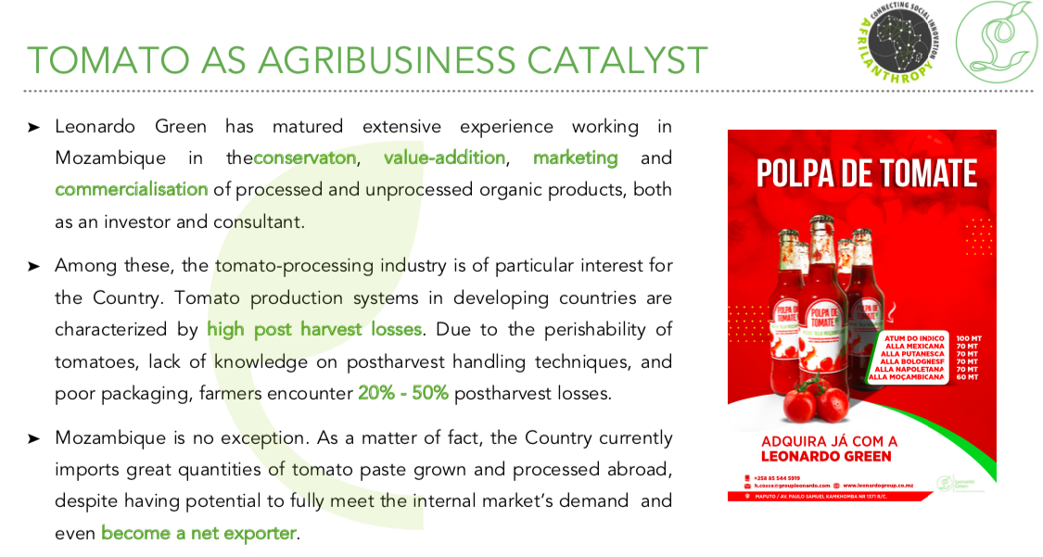
Cabo Delgado Initiatives
OIL AND GAS PROJECTS (PEMBA)
ASSET INTEGRITY (AREA 1)
MANPOWER
RISK ASSESEMENT
SOFT SKILLS TRAINING (AREA 4)
PROJECT MANAGEMENT
SUPPLY OF CABLES (AREA 1)
SCAFFOLDING
LOGISTIC
REAL STATE

Slide 4
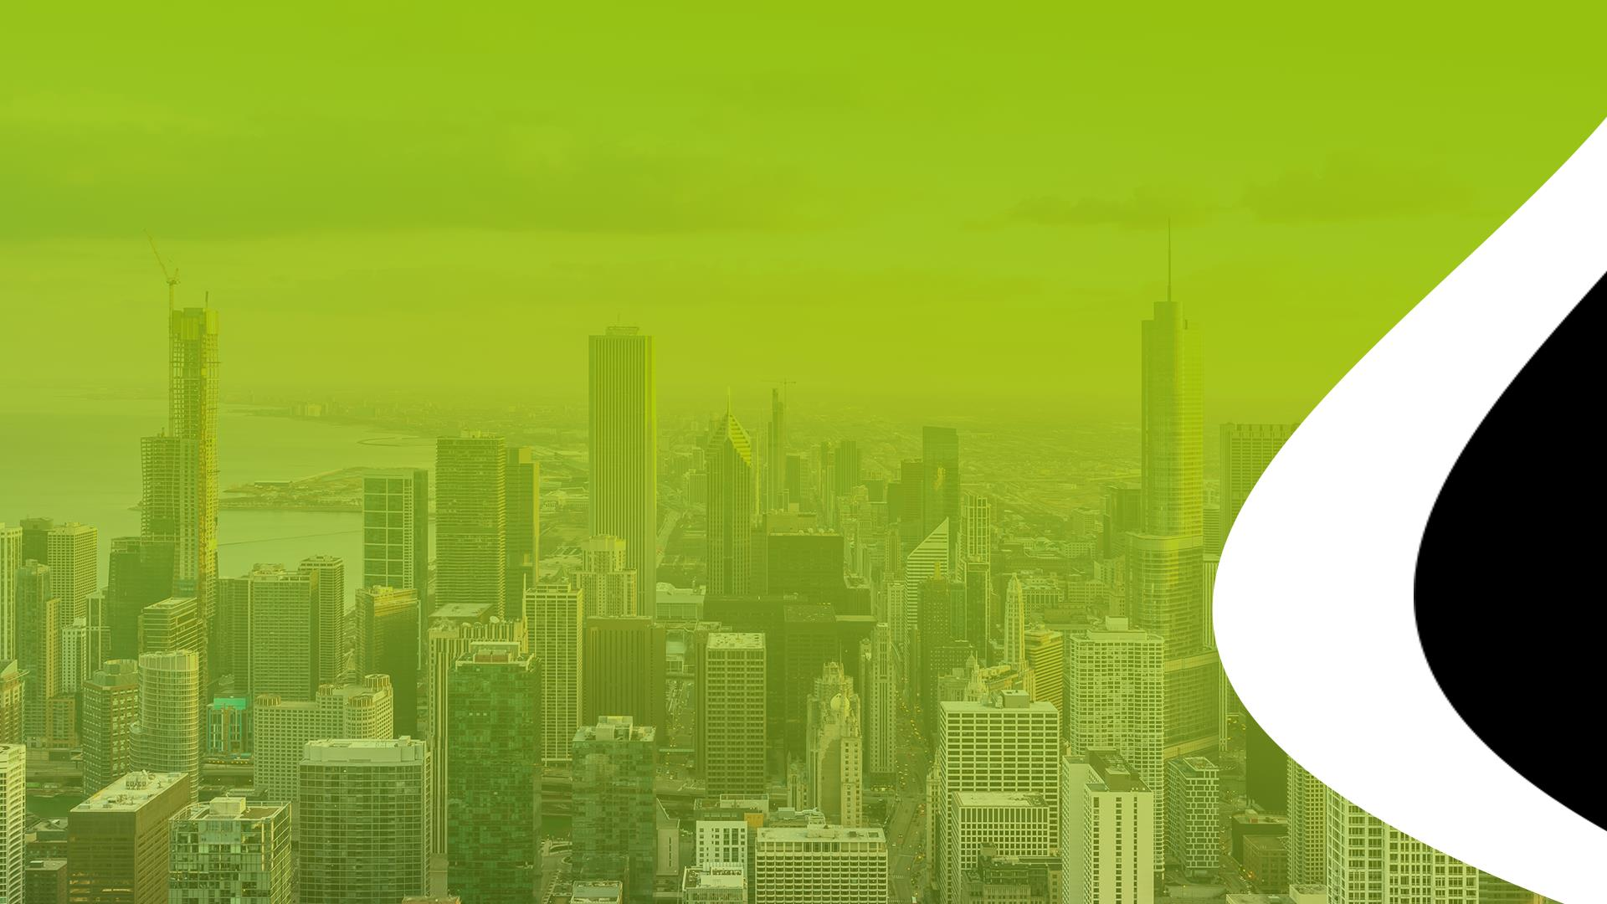
CONTACTS
Av. Paulo Samuel Kankhomba nr 1371 R/C Maputo
Rua Jeronimo Romero RCI006, Pemba, Cabo Delgado
(+258) 86 305 7349
Consultant@groupleonardo.com / s.santi@groupleonardo.com
CTA
www.cta.org.mz
CCMI
(+258) 84 773 1187
Contacto.ccmi@gmail.com
EUROCAM
(+258) 86 754 2605
info@eurocam.org.mz

