Slide 1
Mozambique Gas Summit 2022
Fostering Energy Security – Mozambique as Global Energy partner and supplier
Maputo, September 2022

Slide 2
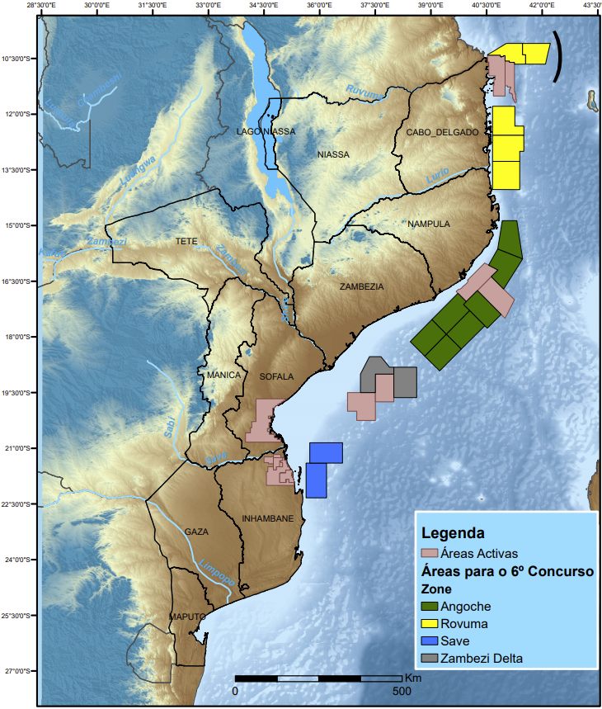
Mozambique as a reliable and stable energy supplier to the world
According to IEA (2022) recent geopolitical upheavals, including Europe growing demand for gas and Asia efforts to overcome the gas prices volatile, might increase the call on Africa’s gas.
It’s forecasted that gas production increases by around 15% over 2020‐30 in the Sustainable Africa Scenario, driven mainly by new projects, including in Mozambique.
Mozambique has around 180 Tcf of natural gas resources and 165 MMbll of in situ oil.
Geological evidence makes it possible to extrapolate the possibility of the existence of fractions of additional resources similar to the discoveries in Areas 1 and 4.
In this scope, the Government launched the 6th Tender with a view to licensing more areas for Natural Gas Exploration and Production.
IOCs recognize the country's potential and demonstrate interests in areas for exploration and production.

Slide 3
LNG is expected to be exported
Current LNG Projects approved in Mozambique
Rovuma Basin | Area | Field | Expected LNG Production
 | Area 1 | Golfinho/Atum | 2 LNG trains 13 MTPA
 | Area 4 | Coral Sul | 3,37 MTPA
 | Area 4 | Mamba + Oligoceno 385 E | 2 LNG trains, ~ 15.2 MTPA
Three (03) projects were approved in areas located in offshore Rovuma basin, and it’s expected that approximately 30 MTPA of LNG will be produced.

Slide 4

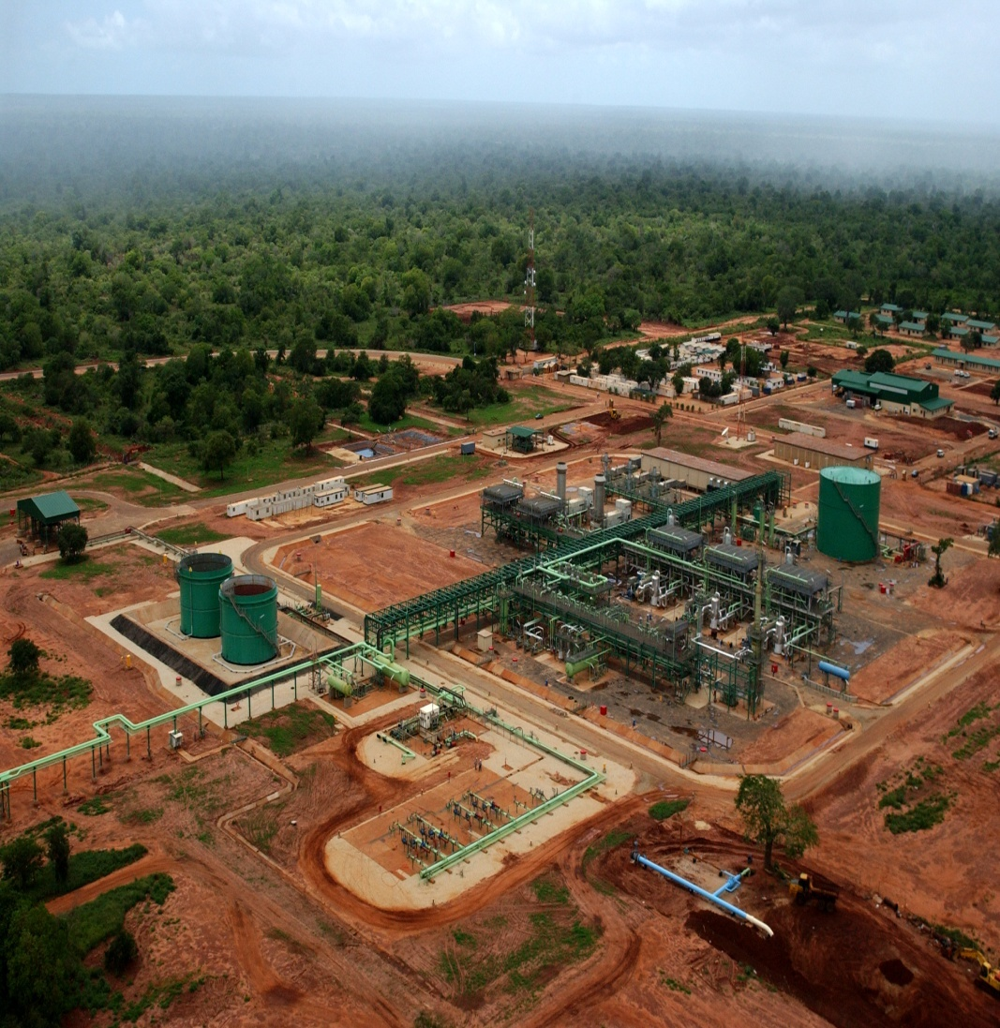
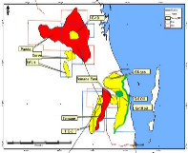
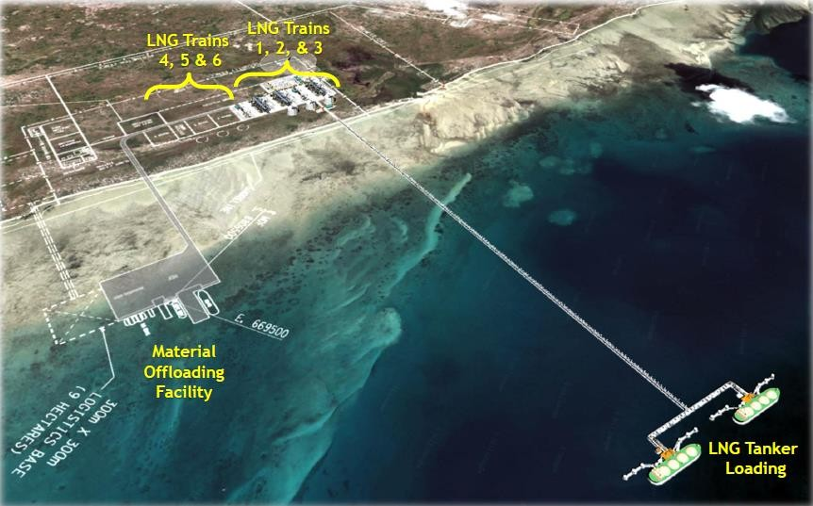
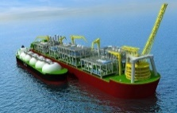
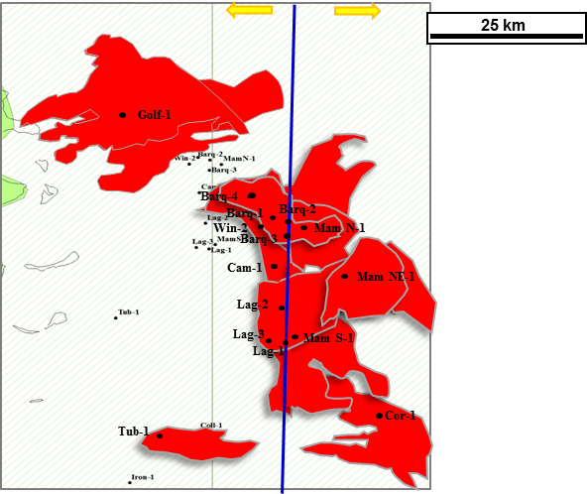
Updates on existing and new gas projects in Mozambique
Projects
Mozambique Basin
Exploration
Development
Production
Decommissioning
Appraisal
PoD approved in 2001
Production Start: 2004
  CPF capacity: 197 MGJ/a;
  Fields currently on production.
Pande&Temane
(Sasol)
PoD approved in Jan 2016
PoD Amendment in 2020
FID in Feb 2021
Plant construction start 2nd semester
  4000 bbl/d of light oil;
  23 PJ of natural gas to feed CTT project;
  30 000 Ton/a of LPG;
  Investment: 1.8 B. USD and 2.4 B.USD of State Revenues.
Inhassoro/Temane
(Sasol)
  Onshore liquefaction plant;
  Two (2) Trains (13.12 MTPA);
  18 Production Wells and 03 underwater gas pipelines;
  2.5 M. USD for Local Content;
  20 B. USD Investment and 32.6 B.USD of State Revenues;
  Suspended due to Force Majeure.
Rovuma Basin
Area 1: Gofinho/Atum (TotalEnergies)
PoD approved in Mar 2018
FID in Jun 2019
PoD Amendment in Mar 2021
PoD approved in Fev 2016,
FID in Jun 2017
FLNG construction start in Mar 2018
Six (6) wells drilled
Commissioning Infrastructure at (99.3%)
  Floating LNG Platform;
  Capacity : 3.37 MTPA;
  Production start 2nd semester of 2022
  7 B. USD investment and 19.3 B.USD of State Revenues.
Area 4: Coral FLNG
(ERB)
  Separate and Coordinated Development (Unified Fields)
  Total Production (25 years): 19.1 TCF;
  Onshore liquefaction plant;
  Two (2) Trains (~15.2 MTPA);
  23 B.USD Investment and 46 B.USD of State Revenues;
  Awaiting the Final Investment Decision.
Area 4: Mamba + Oligoceno 385 E (MRV)
PoD approved in May 2019
Pre-FID in 2019
Area 1: Prosperidade
(TotalEnergies)
Separate and Coordinated Development (Unified Fields)
Unitization agreement approved in May 2019;
Submitted the declaration of commerciality of the Prosperidade field.

Slide 5
Updates on existing and new gas projects in Mozambique (cont.)
Projectos
Bacia de Moçambique
Pesquisa
Período de pesquisa de 4+2+2 anos
Investimento de 80 MUSD
1600 km de sísmica
Abertura de 2 poços de pesquisa
Primeiro Período de pesquisa
Adquiridos 2008 km de sísmica
Espera-se abertura de 2 poços de pesquisa em 2023
Investidos 21.9 MUSD
PT5C
Período de pesquisa de 3+3+2 anos
Investimento de 30 MUSD
600 km de sísmica
Abertua de 2 poços de pesquisa
Terceiro Período de pesquisa
Investimento de 32 MUSD
Adquiridos 600 km de sísmica
Abertos 2 poços de pesquisa
BUZI
Mazenga
Período de pesquisa de 4+2+2 anos
Investimento de 65 MUSD
1500 km de sísmica
Abertura de 2 poços
Primeiro Período de pesquisa
Em curso preparação EIA para aquisição sísmica
Período de pesquisa de 4+2+2 anos
Investimento de 167 MUSD
2500 km de sismica 3D
Abertura de 4 poços
Primeiro Período de pesquisa
Adquiridos mais de 2000 km de sísmica 2D e 3936 km² de sísmica 3D
Prospectividade alto risco
Investidos 34.4 MUSD
Z5C
Período de pesquisa de 4+2+2 anos
Investimento de 202.4 MUSD
3500 km de sismica 3D
Abertura de 5 poços
Primeiro Período de pesquisa
Adquiridos mais de 2000 km de sísmica 2D e 4387 km² de sísmica 3D
Prospectividade alto risco
Investidos 42.2 MUSD
Z5D

Slide 6
Updates on existing and new gas projects in Mozambique (cont.)
Projectos
Bacia de Moçambique
Pesquisa
Período de pesquisa de 4+2+2 anos
Investimento de 213 MUSD
Adquirir 4.500 km² de dados sísmicos
Abertura de 5 poços de Pesquisa.
Primeiro Período de pesquisa
Adquiridos cerca de 8000 km² de sísmica 3D
Abertura do primeiro poço de Pesquisa agendada para Q4 de 2022;
Investidos 80.9 MUSD
A5A
Período de pesquisa de 4+2+2 anos
Investimento de 212 MUSD
Adquirir 8000 km2 de sísmica
Abertua de 5 poços de pesquisa
Primeiro periodo de pesquisa
Adquiridos cerca de 9.000 km² de sísmica 3D dos 8.000 km² previstos
Espera-se a tomada de decisão para o avanço para a perfuração
Investidos 78 MUSD
A5B

Slide 7
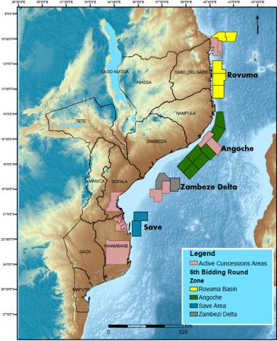
Updates on existing and new gas projects in Mozambique (cont.)
6th Licensing Round
Areas |  | Size
Rovuma Areas (R6-) | 5 Areas | 28241.01 SqKm
Angoche Areas (A6-) | 7 Areas | 40420.79 SqKm
Zambeze Delta Areas (ZD6-) | 2 Areas | 11474.6 SqKm
Save Areas (S6-) | 2 Areas | 11479.35 SqKm
TOTAL | 16 Areas | 91615.75 SqKm
Bid Round Opens
25.11. 2021
Pre-qualification
28.02. 2022
Announcement of Pre-qualified companies
Up to
31.03.2022
Bid Submissions and round closure at 11.11.2022
Applications Evaluation and Bid Round Awards
by
30.12.2022

Slide 8
The role of gas projects to help developing key economic
sectors in the country
To maximize the benefits of the extraction and monetization of natural gas in a sustainable manner, the Government approved, the Natural Gas Master Plan (GMP) in June 2014 which is a guiding and planning instrument of the Government in the gas sector, used as:
  Tool for development of policies in a gas sector in Mozambique;
  Instrument that guides decision-making, establishing priorities in the allocation and use of natural gas
  To Fosters a stable regulatory, fiscal and financial regime promoting the development of the gas sector for the benefit of the country.
  Priority Investment Areas Based on Gas (GMP)

Slide 9
The role of gas projects to help developing key economic
sectors in the country (cont.)
Industrial Sector | Project | Product | Reasoning
Fuels sector | GTL | Diesel /LPG/Nafta | Reduces Mozambique´s dependence on imported refined petroleum products; Potential for regional export of products derived for GTL .
Base Chemicals Sector | Ammonia /Urea and other projects | Ammonia /Urea and other products | Is Government strategy for the development of agriculture and agro-industry; Will provide a reduction in fertilizer imports ; The fertilizer plant in Mozambique can be the distribution center for Africa.
Energy | Power Plant | Electricity | Contributes to the implementation of the Strategy for industrialization and rural electrification; Increases efficiency and flexibility in electricity distribution; Increase in energy availability in the country and region; Contributes to the diversification of the energy matrix.

Slide 10
Final remarks
Recent geopolitical upheavals might increase the call on Africa’s gas.
Mozambique current potential, which is around 180 Tcf of natural gas resources and 165 MMbll of in situ oil, might positively contribute for regional and international gas supply.
Despite the overcoming of energy global disruption, it is forecast natural gas demand growth for at least the next decade, and Mozambique projects have a good potential due to their strategic location, i.e, they benefit of proximity to export LNG to markets such as Asia, region that concentrates the increase for energy demand.
The Government approved the Natural Gas Master Plan (GMP) in June 2014 in order to support local economic development, mainly in fuel, energy, raw materials and base chemical sectors.

