Slide 1
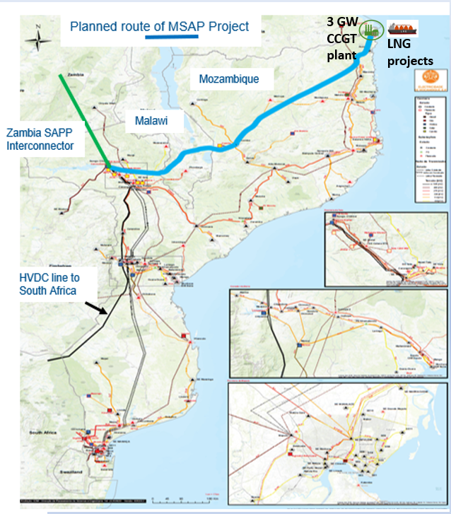
● 3GW high efficiency CCGT plant, to be constructed adjacent to the LNG facilities in Rovuma. ● Gas for the power plant will be sourced from TotalEnergies and/or ExxonMobil onshore facilities through low-cost incremental development of offshore fields under a long-term purchase agreement. ● If ExxonMobil Area 4 onshore facility not developed, augment ENI FLNG development to bring gas to shore to meet domestic supply obligation. ● A 1090 km 2GW HVDC power line to be constructed from the power plant to the Songo HVDC station; the power line will follow the Nacala Logistics Corridor through Malawi. ● HVDC rectifier at Songo to be upgraded to increase existing line capacity to SA to 3960MW – Apollo inverter already upgraded. ● Songo is a regional hub and entry point for the SAPP grid, facilitating sale of excess electricity through the short-term electricity trading system.
MSAPP Power Generation and Transmission
Power Generation
Power Transmission

