Slide 1

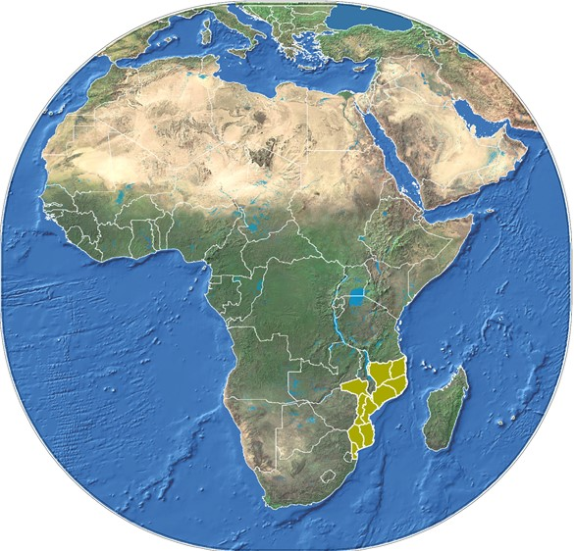
MINISTRY OF MINERAL RESOURCE AND ENERGY
NATIONAL PETROLEUM INSTITUTE
6th Biding Round for Concession of Exploration And Production Areas

Slide 2
Content
  Sedimentary Basins
  Licencing Strategy
  The EPCC
  Licencing History
  Areas for the 6th bidding round
  Available Data
  Pre-Qualified companies
  Licencing Round Roadmap
  Remarks

Slide 3
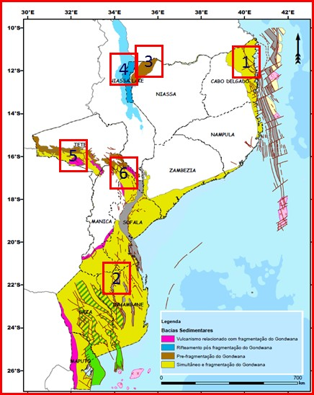
SEDIMENTARY BASINS AND MAIN GEOLOGICAL STRUCTURES
Explored basins (High potencial to Conventional HC’s
Passive Continental Margin basins:
Rovuma Basin (1)
Mozambique Basin (2)
Unexplored basins (High potencial to CBM)
Graben and Rift Type basins:
Maniamba Basin (3)
Lake Niassa Basin (4)
Lower Zambeze Graben (5)
Middle Zambeze Basin (6)

Slide 4
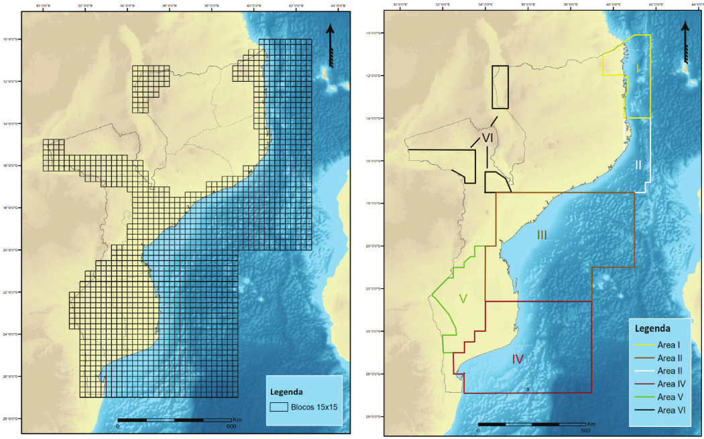
Licensing Strategy
Resolution no. 39/2021 from 4th August
Define the need to have a systematic assement of Petroleum potential
Define areas to be covered by data acquisition
States that the Licensing rounds are undertaken in two years period
Licensing can only be undertaken over areas covered by data

Slide 5
The Exploration and Production Concession Contract
Grants the following rights
Exploration for a maximum of 8 years.
Exclusivity on undertaking pertroleum operations.
Exclusivity to construct and operates infra-structures (Pipeline).
Assessement of commerciality in case of discovery for a period of 2 years.
Development and production for a maximum period of 30 years.

Slide 6
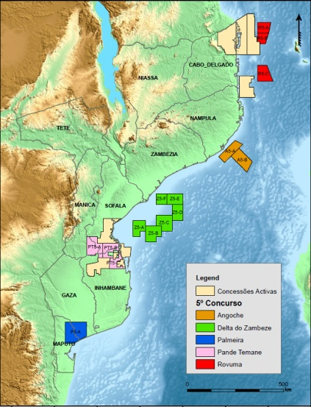
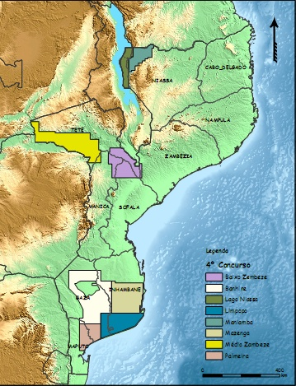
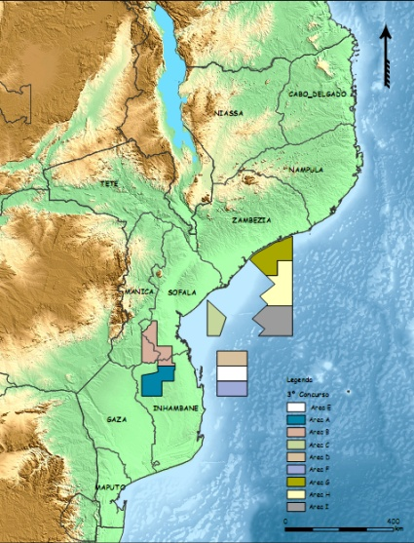
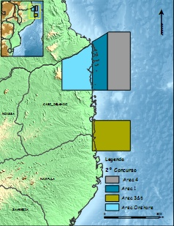
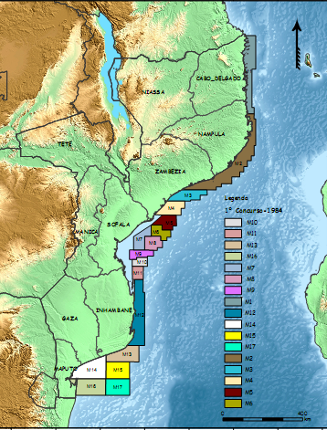
LICENCING HISTORY
5th - 2014
4th - 2009
3rd - 2007
2nd - 2005
1st - 1984

Slide 7
LICENCING HISTORY

Slide 8
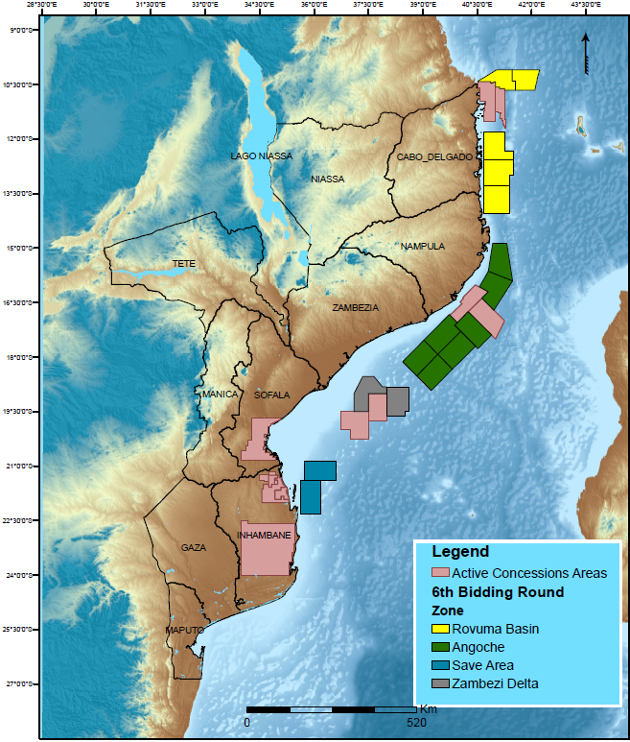
Areas for the 6th Licensing Round ongoing
Rovuma Areas (R6-) 5 Areas 28,241.01 SqKm
Rovuma
Angoche Areas (A6-) 7 Areas 40,420.79 SqKm
Angoche
Zambeze Delta Areas (ZD6-) 2 Areas 11,474.6 SqKm
Zambeze Delta
Save Areas (S6-) 2 Areas 11,479.35 SqKm
Save
Total: 16 Areas 91,615.75 SqKm

Slide 9
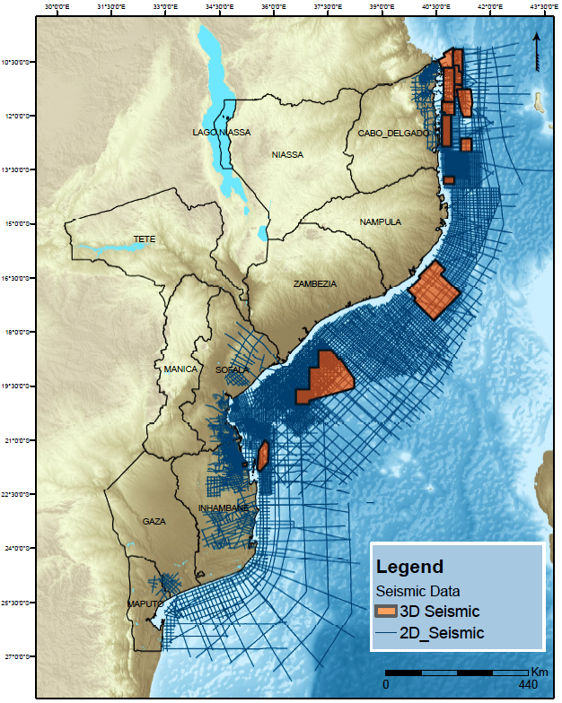







Geotechnical Data
The geotechnical Data includes:
  Seismic 2D/3D
  Grav/Mag
  Wells
  Regional reports
Access to the Data through a Master License Agreement
  Fisical Data Room
  Virtual Data Room

Slide 10


6th LICENSE ROADMAP
Bid Round Opens
25.11. 2021
Pre-qualification
28.02. 2022
Announcement of Pre-qualified companies
Up to
31.03.2022
Bid Submissions and round closure at 12h00, 11.11.2022
Anouncement of the results
up to
30.12.2022

Slide 11
Pre-qualified companies
Operators
CNOOC (CHINA NACIONAL OFFSHORE OIL CORPORATION HONG KONG HOLDING LIMITED);
SINOPEC INTERNATIONAL ENERGY INVESTMENT LIMITED;
ENI MOZAMBICO SPA;
EXXONMOBIL MOZAMBIQUE (OFFSHORE 6) LIMITED;
PETROCHINA INTERNACIONAL IRAQ FZE;
TOTALENERGIES EP NEW VENTURE.
Non operators
RN ANGOCHE PTE
JOINT STOCK COMPANY NOVATEK
QATAR PETROLEUM MOZAMBIQUE LIMITADA
SASOL AFRICA (PTY), LTD
ONGC VIDESH LIMITED
DISCOVERY EXPLORATION LIMITED (Renounced)

Slide 12
Benefits for the Pre-qualified companies
  Opportunity to license and interpret data
  Pre-qualified companies are alreday known and it is time to form applicants groups
  Significant Petroleum potential is available over the areas in offer
  Mozambique offers competitive and attractive Legal and Fiscal regime
  Submission of competitive bids to explore for further petroleum resources
  Contribute to bring resources for the energy transistion strategy

Slide 13
Final Remarks
  Petroleum potential has been proved around Rovuma, Zambezi and Save Regions
  Mozambique offers competitive and attractive Legal and Fiscal regime
  Stimulate foreign direct investment in the Petroleum sector
  Contribute to implement the energy transition process and use the available opportunity to license and explore more acreage
  Mozambique offers prospective acreage and Oil companies are encouraged to participate in this 6th licensing round and in the upcoming opportunities.

Slide 14
THANK YOU

