Slide 1
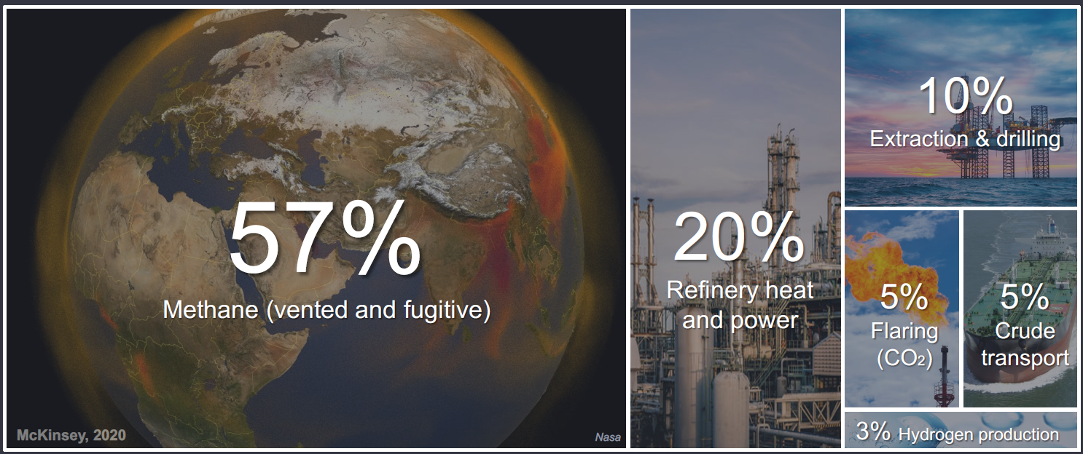
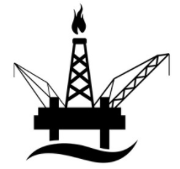
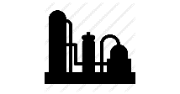
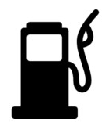
Oil & Gas Emissions
2019 Estimates
23GT CO2E – Oil & Gas related
The oil & gas industry = 5 GT
Using the refined products = 18 GT
32GT CO2E – outside Oil & Gas
Source: IEA, McKinsey 2020
Notes:
In 2020 it’s estimated that 42%, or 23GT of the worlds CO2 production is related to the oil and gas industry. Of these, 5GT are related to the value chain of getting it to market, defined as scope 1 and scope 2 emissions. The rest comes from Scope 3, mostly from the burning of end-use fuels, such as diesel and gasoline.
More than 50% of the emissions from the oil and has value chain are related to methane leaks in during transportation and in processing facilities. However, due to the challenge of observing and measuring these leaks, the number is indeed still quite a rough estimate in reality. New advances in measurement technology (watch this space ☺) will hopefully improve the precision and allow action to be taken. Downstream activities, such as the heat and power required for refineries is the next biggest emitter, followed by extraction / drilling, flaring, crude transport and hydrogen production.
In order to reduce CO2 to net zero in 2050, and by 40% in 2030, all of these sources will need to be addressed – even the smallest ones.

Slide 2
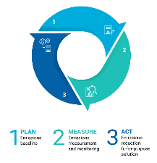
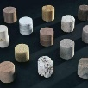
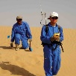
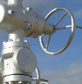
Taking Climate Action in Schlumberger
Getting to Net Zero by 2050
Investing in the Energy Transition
Oil & Gas Decarbonization
Core Portfolio
New Energy
Digital
Transition Technologies
Nuclear
Coal
Schlumberger End-to-end Emissions Solutions
Hydro Power
Oil
Solar
Gas
Wind
Hydrogen
Drilling Emissions Management
Lithium
CCS
Bioenergy
Geoenergy
Geothermal
Carbon Services for CO₂ Storage
Transition Technologies is a mark of Schlumberger.
Notes:
This slide highlights the three main SLB pillars that support taking climate action
Our net zero commitment, which is inclusive of scope 3 emissions. This means we are committed to reduced our net GHG footprint to zero by 2050, inclusive of emissions coming from our entire value chain (what we buy and what we sell).
Our investment towards the energy transition
Decarbonizing oil & gas operations. With 10% of global emissions coming from oil & gas, and no quick avenue to move away from hydrocarbons as a key energy source, reducing emissions from this industry is critical.
Investing in energy sources and carriers outside of oil & gas.
Within oil & gas decarbonization there are growing number of offerings.
Transition Technologies: Field proven solutions within our core business lines that quantifiably reduce customer emissions
Schlumberger end to end Emissions Solutions (SEES) – and end to end service that focuses in on methane and routine flare emissions.

Slide 3
Driving Superior Business Outcomes with More Energy, Less Carbon
Less NPT
Less Waste
Less Driving
Less Resources
Less Emissions
Less Carbon
Less Cost
RETURNS
Capital Efficiency
+
More
SUSTAINABILITY
More Energy, less Carbon
+
EARNINGS GROWTH
Cost Efficiency & Consistency
Ezinne Nnebocha |Sales and Marketing Director, Central East Africa
Notes:
Many customers have been asking us what we can do to help immediately. What you see here, is a key step: Making our existing decarbonizing solutions more easily visible through a common label, so operators can make more informed choices, more easily.
The label is called transition technologies, because they help accelerate the path to net zero for the energy industry by reducing the carbon-intensity of oil and gas today, while in parallel we work towards other sustainable energy sources for the future.
However, we not only want to reduce emissions, we also want to help safe-guard and improve the competitiveness of the E&P sector. So, as we work together to drive out carbon from our joint projects, we must make sure that “Less is always More”. In this way, we ensure that sustainable practices & technologies are not only the right thing to do; they also deliver superior business results.
In order to be labelled as “transition technology”, a solution thus must not only pass a rigorous technical qualification process, it must also provide a robust value case for our customers: Amplifying the desired business outputs while simultaneously reducing environment impact. Transition technologies drive efficiency, they drive reliability, they drive performance. Sustainably.

Slide 4
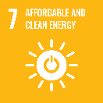
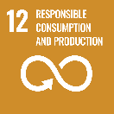
Our Approach: Sustainability Through Technology
Environmental Focus
Solution Attributes
Our United Nations
Emissions Reduction
Energy Consumption Reduction
Electrification
Surveillance & Assessment
HazMat Reduction
Water Stewardship
Waste Reduction
Size Reduction
Image source: UN.org
Notes:
Many communicate sustainability objectives using the UN framework, and that’s why we decided to anchor our approach and actions in the UN Sustainability Goals, or SDGs.
On the left here, you can see the 6 environmental SDGs that Schlumberger has adopted as most relevant to our technology portfolio. Additionally, we included SDG17 to reflect the importance of collaborative partnerships to guide the right actions and to achieve the desired results.
Alongside, we developed 8 attributes to allow technology design choices to be captured more easily in our R&D process. Currently our quantification work is focused on the first 3 attributes; as they promise the highest short term impact. Additionally, we are fast tracking technologies that help monitor and assess carbon footprint, which will help inform your decision making, accelerate our learning and guide our way forward.

Slide 5
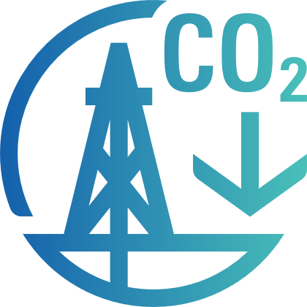
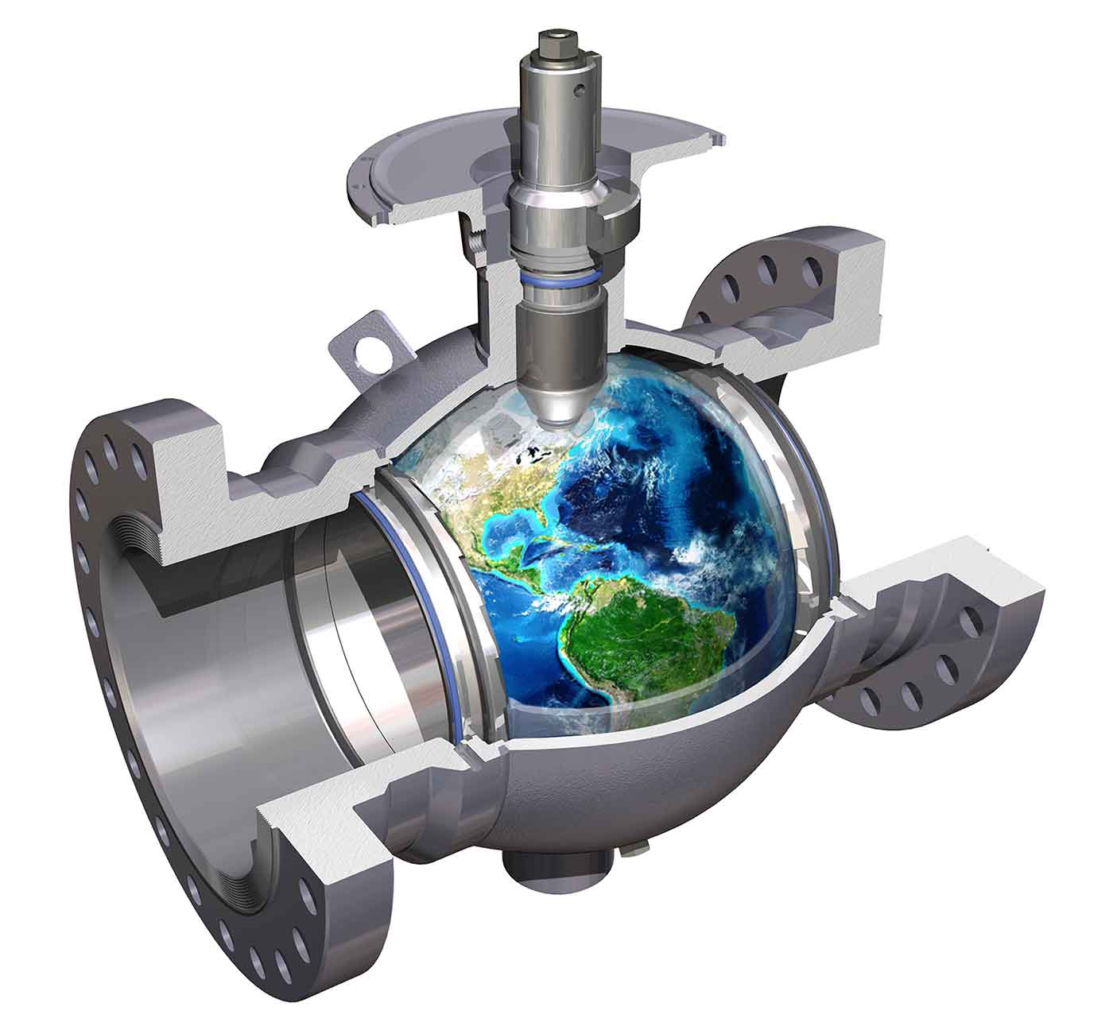
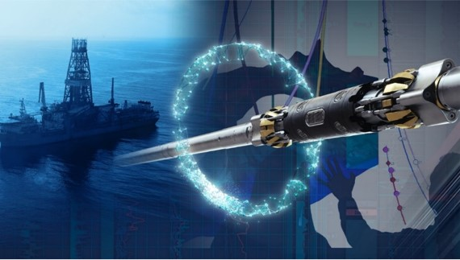
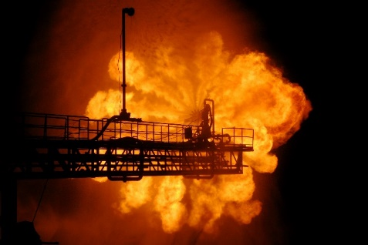
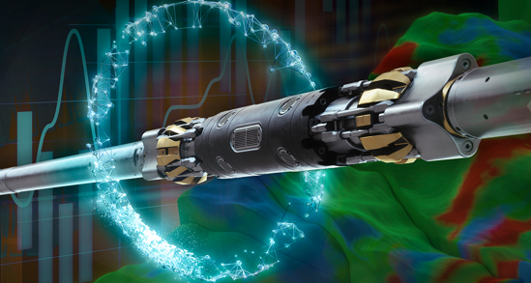
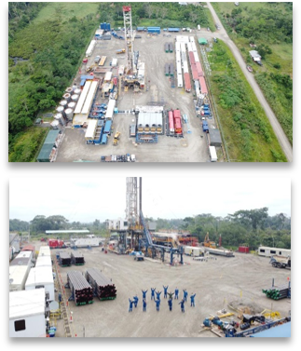
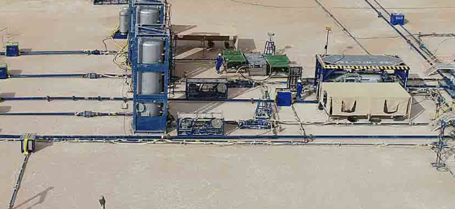
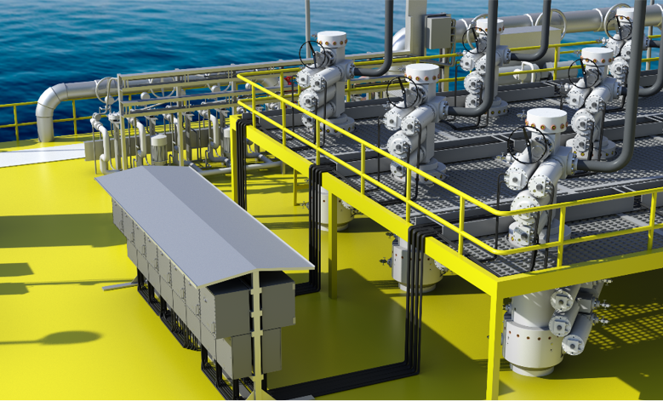
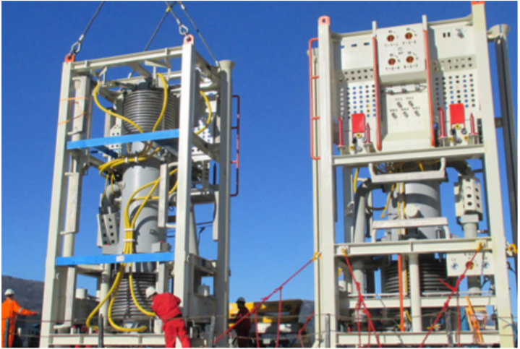
Transition Technology
Address Methane Emissions
Reduce/Eliminate Flaring
Minimize Well Construction Footprint
Full Field Development Solutions
Electrification

Slide 6
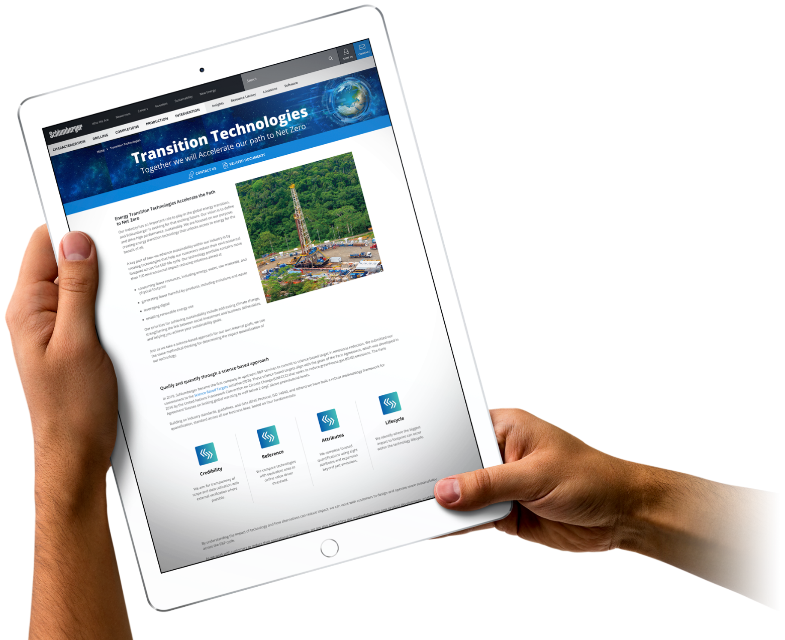
Learn More about Our Transition Technologies
slb.com/transitiontechnologies
Notes:
Our transition technologies portfolio will continue to grow, as we mature our quantification efforts further, and as we bring new technologies to the market that satisfy the strict criteria we have set for the portfolio.
Once it’s up and running, you can also find a lot more information on our website, where we have created a space with more in-depth information around the scientific approach to the qualification of the technologies, information about the technologies themselves and relevant success stories.
Make a note of this logo (reference to logo on slide), this is the mark for all our transition technologies. This means that the technology is tied to one of the 8 attributes and are linked to a U.N. SDG. This also means that this technology has been certified by our experts and includes a proven quantification of the impact reduction it provides.
So, check out the technologies and solutions you see marked with this logo, they may have a significant impact on your path to net-zero! …and check back often, as we will rapidly expand our transition technology portfolio in 2021!

