Slide 1
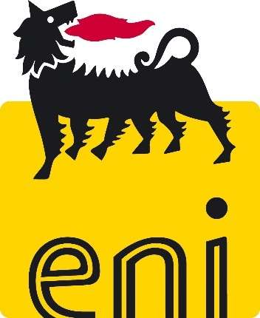
Eni in Mozambique: Supporting the energy transition
Giorgio Vicini, MD, Eni Rovuma Basin
14th September 2022

Slide 2
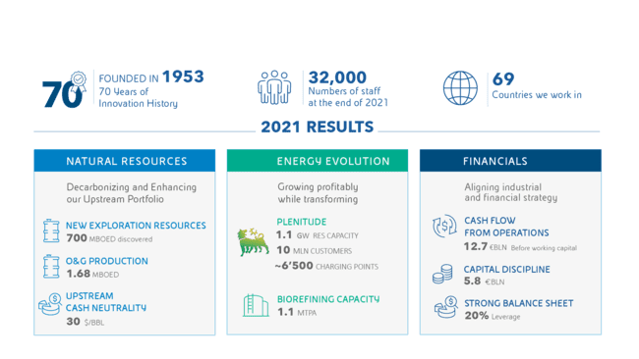

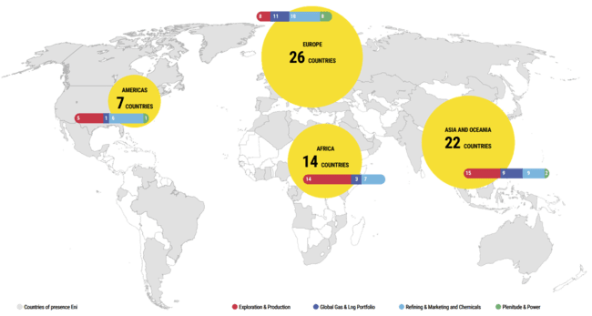
Eni at a glance
FOUNDED IN 1953
70 Years of
Innovation History
31’888
Numbers of staff
At the end of 2021
69
Countries
we work in
Listed Since 1995
E NYSE
ENI MIB
2
Notes:
Eni is an integrated energy company with almost 32,000 employees in 69 countries around the world.
We are active at every stage of the value chain: from natural gas and oil to co-generated electricity and renewables, including both traditional and bio refining and chemicals
We are taking real action to support a just transition that creates long-term value and allows everyone to access to reliable and clean energy while protecting the environment.

Slide 3
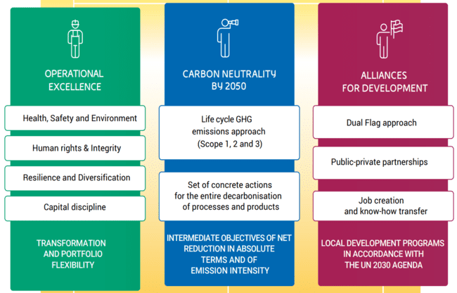
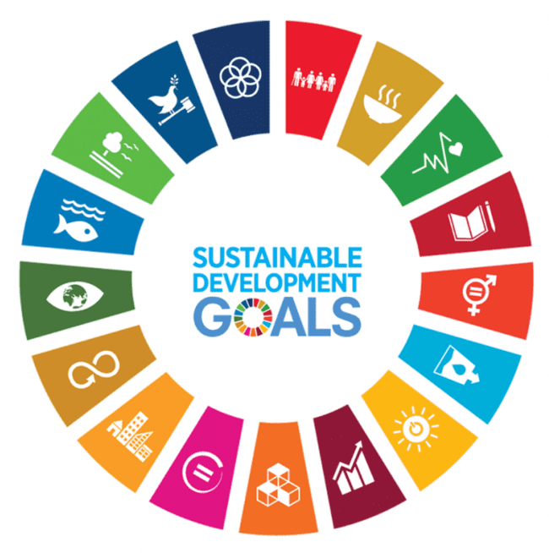
Our business model
Exploration &
Production
Refining &
Marketing
and Chemicals
Global Gas &
LNG Portfolio
Plenitude &
Power
3
Notes:
Eni business model is aimed at the creation of value for all stakeholders through a strong presence along the entire value chain of energy: from natural gas and oil to co-generated electricity and renewables, including both traditional and bio refining and chemicals.
Eni organically combines its business plan with the principles of environmental and social sustainability, extending its range of action along three pillars:
Operational excellence: commitment to valuing people, safeguarding both the health and safety of people and asset integrity, protecting the environment, integrity and respect for human rights, resilience and diversification of activities and ensuring sound financial discipline.
Carbon neutrality by 2050: our path to reduce carbon footprint, by monitoring GHG life cycle and taking concrete actions to reach full decarbonization.
Alliances for development: enhancing the resources of the Countries where we operate, promoting access to electricity and developing Local Development Programs with a broad portfolio of initiatives in favor of communities. This distinctive approach, referred to as Dual Flag, is based on collaboration with other internationally recognized players, in order to identify and address the needs of communities. We are also committed to creating job opportunities and transferring know-how and expertise to our local partners.
Eni aspires to contribute to the achievement of the Sustainable Development Goals (SDGs) of the United Nations 2030 Agenda, supporting a just energy transition that meets the challenge of climate change with concrete and economically sustainable solutions by promoting efficient and sustainable access to energy resources, for all.

Slide 4
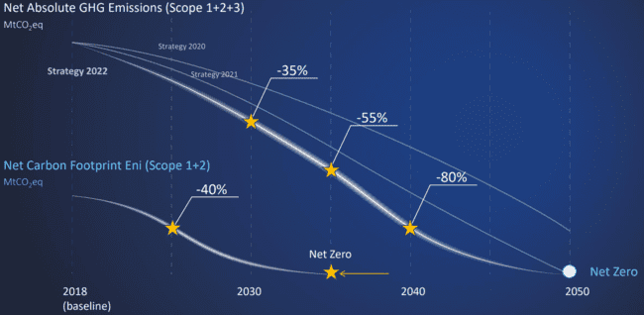
Towards a Net Zero Energy Business
Accelerating our GHG emission reduction targets
Multiple business levers to reach targets
Net zero carbon footprint (scope 1+2) by 2035
Net zero carbon footprint (scope 1+2+3) by 2050
4
Notes:
Eni’s business model envisages a decarbonization path towards carbon neutrality by 2050.
We have accelerated our GHG emission reduction targets, through multiple business levers that will lead to the total decarbonization of processes and products. Specifically:
Net zero scope 1+2+3: 35% reduction by 2030 and 80% by 2040 vs 2018 levels.
Net zero scope 1+2: emissions cut by 40% by 2025 (vs 2018 levels), on the way to net zero by 2035 – five years earlier than previously planned
While reducing emissions, Eni will develop a growing offer of full decarbonized Energy solutions to customers:
Plenitude will offer green electricity to all retail power customers , developing more than 15 GW Renewable Capacity by 2030
Biorefining capacity will grow up to 6 MTPA in the next decade
Hydrogen will contribute to our plan for around 4 MTPA by 2050
In the next decade the first commercialMagnetic Fusion plant will be developed, potentially opening the route for a limitless source of clean, safe and secure energy.

Slide 5
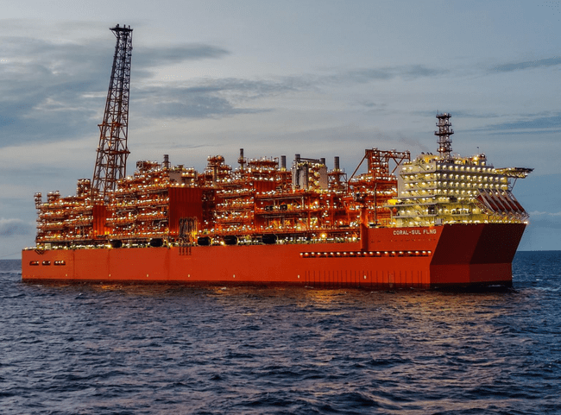
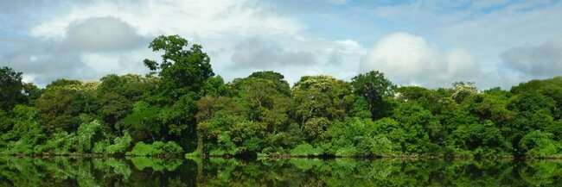
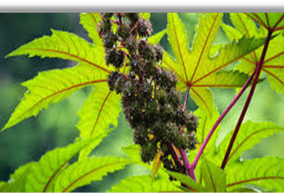
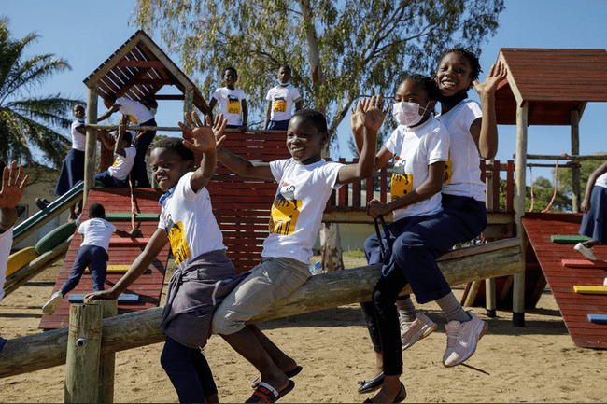
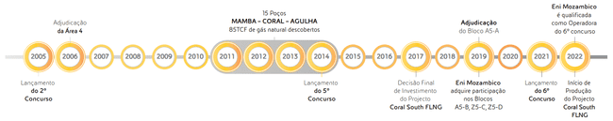
Our Activities in Mozambique
Exploration & Production
Coral South FLNG: production expected
in 2022 (3.4 MTPA)
Exploration: activities ongoing in frontier
areas
Carbon Offset Initiatives
Limpopo REDD+ project
Sofala Mangal REDD + feasibility study
Improved Cookstoves
Biochar
Agri-Hub Program
Biofuels for energy transition: oilseeds
oils as bio-feedstock
Agricultural development & income
generation for local producers
Development programs
Education
Clean cooking
Pro-Resilience
Emergency response
Timeline of Eni’s Presence
15 wells
MAMBA-CORAL-AGULHA
85 TCF of natural gas discovered
Eni Mozambico qualified as operator of 6th bid round
Area 4
awarded
Block A5-A
awarded
2nd bid round
launched
5th bid round
launched
Final Investment Decision of Coral South FLNG project
Eni Mozambico acquires participations in blocks A5-B, Z5-C, Z5-D
6th bid round
launched
Coral South FLNG production start-up
5
Notes:
Mozambique is one of the most promising countries on the African continent for the energy sector: We have been present in the country since 2006.
With regards to Exploration & Production, the Coral South FLNG Project, operated by Eni on behalf of Area 4 partners, is expected to start LNG production by the end of 2022, adding Mozambique to the LNG-producing countries.
In addition to that, we are also running exploration activities in frontier areas.
We are also active in the production of biofuels with the Agri Hub program. Eni is expanding in Mozambique beyond Oil & Gas, leveraging the country’s agricultural potential to produce agri-feedstock, without competing with the food, boosting local development and promoting a source of income for local producers.
Aligned with our company’s decarbonization path, several carbon compensation initiatives are present in the country, including:
conservation projects;
mangrove restoration projects
Improved cookstoves distribution
biochar valorization
Our development programs in the country include initiatives to ensure access to education, access to energy, access to health, pro-resilience projects and emergency response projects

Slide 6
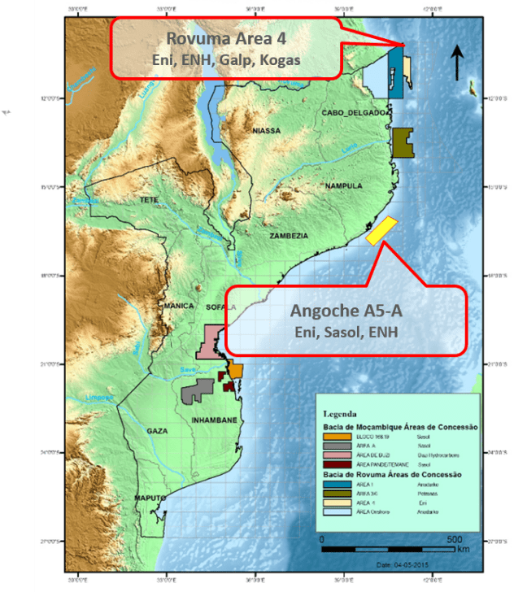
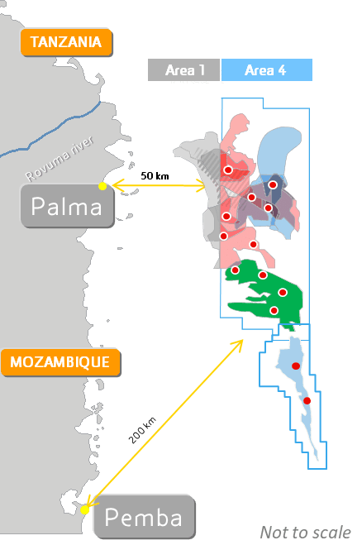
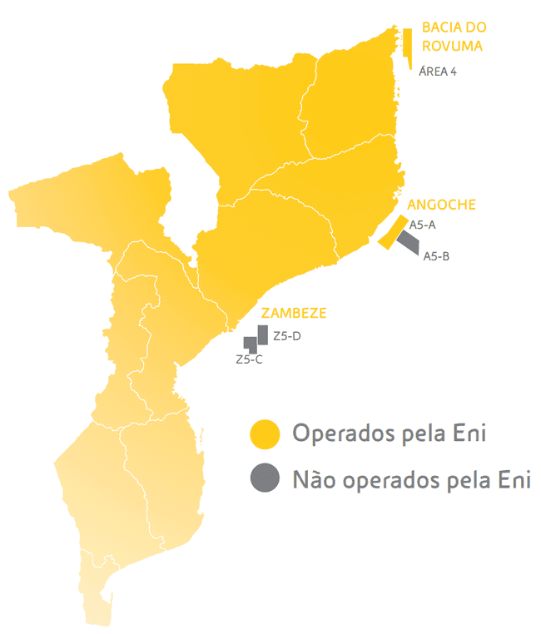

Eni in Mozambique: Creating Long Term Presence
Rovuma
Basin
Development: Rovuma Area 4
Between 2011 and 2014, Eni made a Super Giant Discovery (~ 85 TSCF GIIP) of world class gas reserves in Area 4 Rovuma Basin
Coral South FLNG project – under operation ~5 TSCF
Rovuma LNG Project – approved PoD ~19.1 TSCF
Committed to future projects to develop the remaining resources.
Angoche
Basin
Zambezi Basin
Operated by Eni
Not operated by Eni
Exploration: Angoche and Zambezi Areas
Despite Super Giant Discovery made in Area 4, Eni continues to run activities in the frontier deep waters of the Angoche and Zambezi basins
Eni was qualified as operator to participate to the 6° Bid Round
6
ENI: BEST-IN-CLASS EXPLORER FOR OVER A DECADE
Notes:
Eni is known worldwide for his explorative success; we have recognized as the best-in class exploration company for over a decade.
Over the last 15 years, one of the most significant success has been the Super Giant Discovery in Area 4 Rovuma Basin in Mozambique, discovering around 85 TSCF of gas.
As mentioned in the previous slides, part of this gas will be commercialized before the end of 2022 thanks to the Coral South FLNG project, for a total volume up to 5 TSCF. As we can understand, there is significant potential to be exploited in Mozambique offshore waters, and Eni is committed to future projects to develop these remaining resources.
Exploring for hydrocarbons is still a distinctive competence of Eni. In these years, exploration activity granted both the replacement of produced reserves with a competitive discovery cost per boe, which is the first step to reduce the break-even of upstream projects, and a robust contribution to the cash generation through the deployment of the Dual Exploration Model.
In carrying out exploration activities, Eni has expertly combined initiatives in near-field exploration with high-risk/high reward plays like the frontier areas in the Angoche basin.
Eni has always sought after innovative technological solutions aimed at maximizing economic results and is therefore equipped with a wide range of distinctive and proprietary tools which cover all the key technologies required to maximize the exploitation of new assets. Furthermore, we have been qualified as operator to participate to the next 6th bid round.

Slide 7
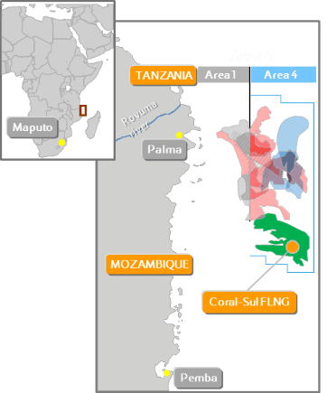
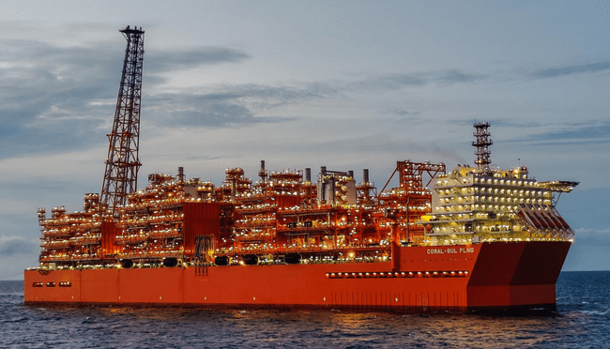
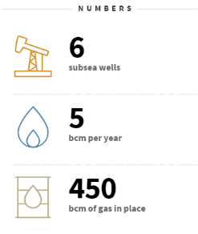
Coral South Project
Coral South Project comprises the production of 6 subsea wells, connected to a new built Floating Facility (FLNG) for gas processing, liquefaction, storage and offloading of LNG.
Hydrocarbon Introduction to the FLNG took place on 18th June 2022
First LNG Cargo is scheduled in second half of 2022
Expected cumulative gas production ~5 TSCF, out of ~16 TSCF of total gas in place
6
Subsea wells
3.4
MTPA per year
16
TSCF of gas in place
Notes:
The Coral South project was launched in 2017, just three years following the drilling of the final exploratory well. We have built a floating facility for the treatment, liquefaction, storage and export of gas (FLNG) with a capacity of around 3.4 million tonnes of LNG per year, powered by 6 underwater wells with start-up expected in 2022.
On the 18th of June 2022, we announced that the Coral South FLNG Project has safely achieved the introduction of hydrocarbons to the Coral Sul Floating Liquefied Natural Gas (FLNG) plant from the Coral South reservoir offshore Mozambique.
Coral South FLNG will now be ready to achieve its first LNG cargo in the second half of 2022, adding Mozambique to the LNG-producing countries.
The total gas volume that will be sold is around 5 TSCF. This leaves space for further field development as the total gas in place is around 16 TSCF.

Slide 8
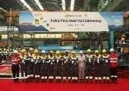
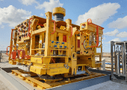

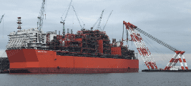
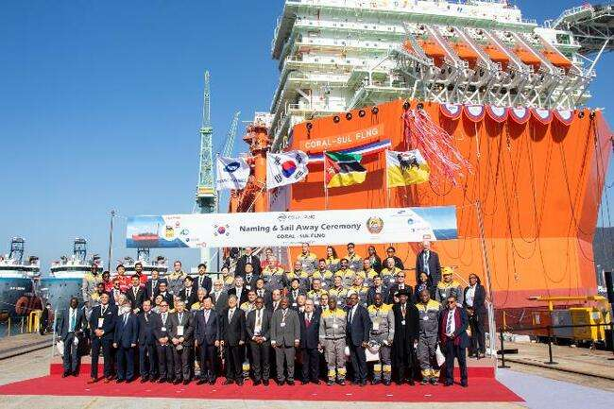
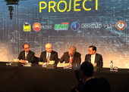
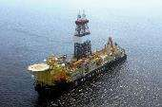
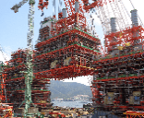
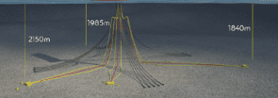
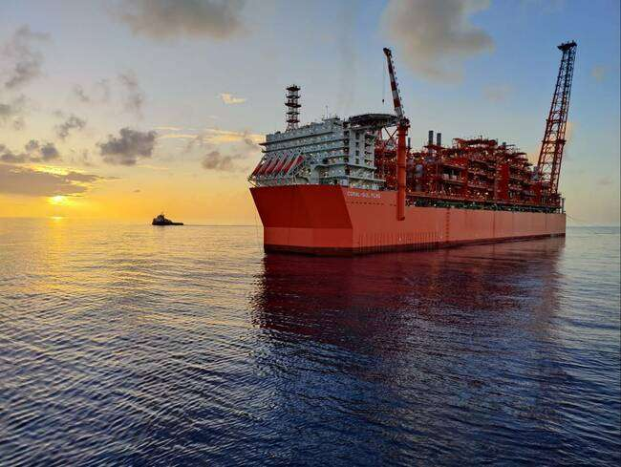
Coral South FLNG Project Timeline
FLNG Sail Away
16 Nov 2021
First LNG Cargo – 2H 2022
FLNG First Steel Cut
September 2018
6 XTs Delivered to Mozambique
October 2019
Hull Launch
January 2020
Last Module lift
October 2020
FID
June 2017
Start of Drilling Campaign
September 2019
First Module lift
May 2020
Start of Installation Campaign
2Q 2021
End of D&C Campaign
Nov 2021
HC-In 18 June 2022
Notes:
The Coral South project was launched with the FID in 2017, just three years following the drilling of the last appraisal well.
We are proud to highlight that in 2017, when we reached FID, we committed to developing the project in 5 years. Today, 5 years later, we can confirm startup before year end, in time, on schedule, on budget: a testament to Eni’s project management abilities
The main milestones were:
In 2018 the first steel cuts for the hull and topsides
In 2019 we had the XT delivered to Mozambique and the start of the drilling campaign
In 2020 we had the hull launch and the lifting and installation of all topside modules
In the meantime, between 2019 and 2021 the drilling & completion campaign of all the six wells was completed
FLNG sailed away from South Korea in November 2021 and arrived in Mozambique in January 2022
On the 18th June 2022, Eni announced the first introduction of hydrocarbons into the FLNG plant.
Coral South FLNG will now be ready to achieve its first LNG cargo before the end of 2022, adding Mozambique to the LNG producing countries.

Slide 9
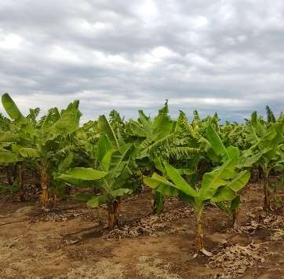
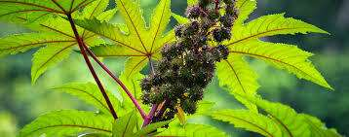
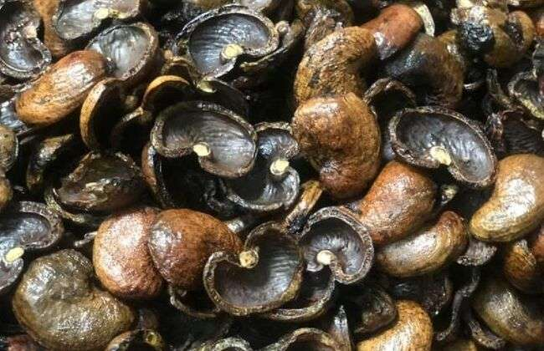
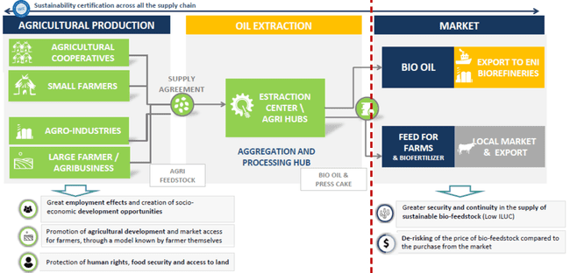
Biofuel Feedstocks: Agri-Hub Program
Eni is expanding in Mozambique beyond Oil & Gas, leveraging Mozabique’s agricultural potential for generation of biofeedstock and in line with de-carbonization targets, without competing with the food production crops and agriculture lands
  Specific Agreement between ERB and MADER signed on February 2022 to assess the potential of integrated initiatives for production of Bio-feedstock Oil
  Bio-feedstock Oil develop from oilseeds crops (not in competition with food) using Oil Extraction Process plants to be located near agricultural areas (Agri Hubs)
Biochar derived from press cake of oil extraction to contribute on carbon neutrality and to improving soil quality
Biochar
9
Notes:
Hydrocarbon production is not the only area of activity of Eni in Mozambique.
Eni is also developing new initiatives in the agribusiness, to produce feedstock for its bio-refining system.
Biofuels play a key role in Eni’s commitment to reach full decarbonisation of its products and processes by 2050: today Eni is the world’s 2nd producer of biofuels. The company increasingly relying on a vertically integrated production of agrifeedstock, which is in line with de-carbonization targets, does not compete with food crops and agriculture lands. At the same time these initiatives boost local development and promote an additional source of income for local producers.
In February 2022, Eni and the Ministry of Agriculture and Rural Development of the Republic of Mozambique (MADER) signed an agreement to develop agricultural projects aimed at producing oil seeds and vegetable oils to be used as agri-feedstock for the production of biofuels.
Under the agreement, Eni and MADER will assess potential sites and the most suitable crops for the production of oil seeds and vegetable oils, focusing on areas that would not compete with food production and taking into consideration the preservation of forests and natural ecosystems. Feed for animals and biofertilizers are by-products to valorise from the Agrihub process too.
Eni will leverage the experience gathered in Kenya, where Eni’s first Agri-hub is already operational, and in the Republic of Congo, where pilot projects are at an advanced stage. Mozambique has a great agricultural potential, and this area of activity will trigger new businesses and generate income and jobs
Agri-Hub Program highlights:
Country Area: 79M ha, Agriculture Area: 41M ha, of which 6M ha planted
GDP agricoltura: 26%, main plantations: corn (2,2M ha; 1,08 t/ha), beens (0,9M ha; 0,4 t/ha), yuca (0,9M ha; 6,6 t/ha)
Biofeedstock potential with oilseeds crops not in competition with food
Fast track Early Production of 10Kton/year from 2023 (expandable to 30 Kton/year)
Agrihub allows to use wastes to process by-products such as Biochar contributing to the carbon neutrality and improving soil quality. Plan embeded within the production targets of Biofuels feedstokes in the Agri-hub
Eni is levering experience in other african countries where agrihubs are already constructed or under construction
Project Status:
Agricultural Assessment Areas Ongoing to identify potentiality, locations, farms and crops fucntional to the agrihub
Business model definition ongoing in terms of Locations, Volumes based on country potentialities
Pilot Field – experimental testing to start by end of september in IIAM fields (Mozambique's Institute of Agricultural Research)
Specific Operating agreemeent ongoing between ERB and IIAM to execute the Pilot Fields in Umbeluzi (moputo Province) and later in Chowke and Nampula
Assessment on Cashew Nut Shell ongoing. Potentialities exists and testings on Cashew nut shell ongoing in laboratory in Milan
Feasibility Study to be finalized by Nov/Dec 2022 including the proposal for a first agrihub of 10Kton/y (expandable to 30 Kton/y)
Location of First Agrihub under evaluation according to the potentialities of the territory. Nampula or Maputo Provinces are the likely locations for the first Hub
Permitting process under evaluation tointerface with authorities to allow smooth approval process

Slide 10
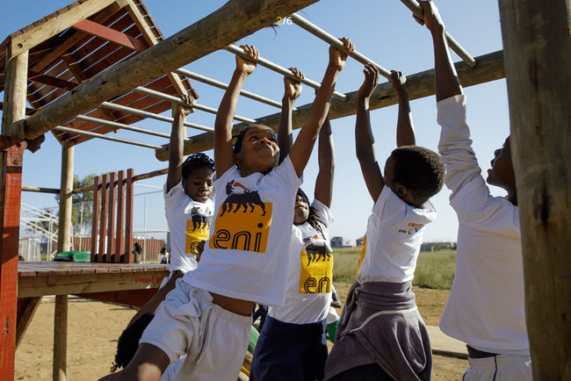
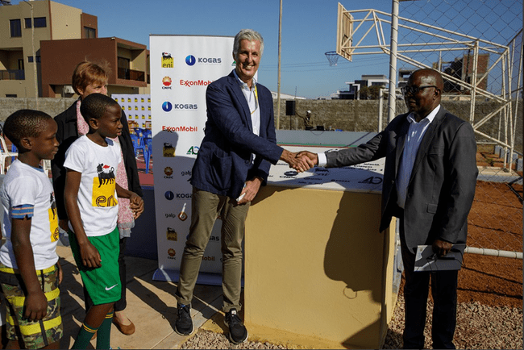
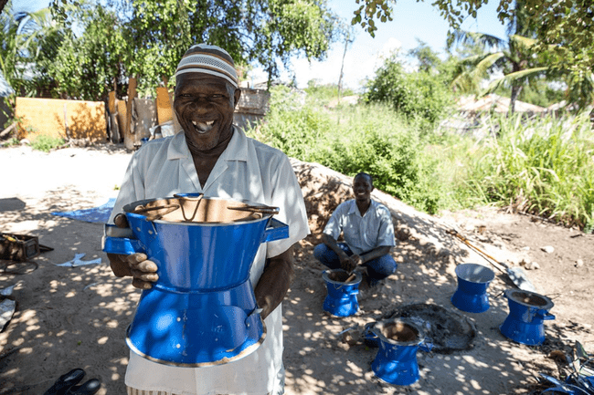
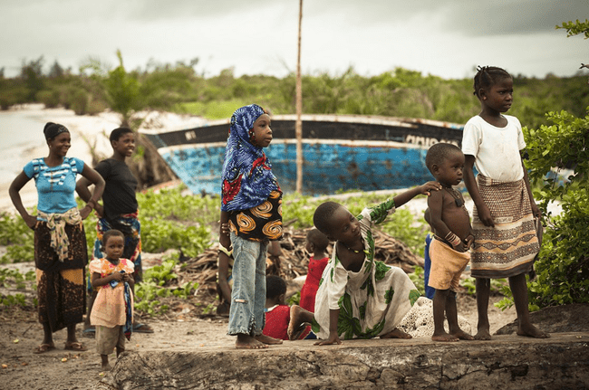


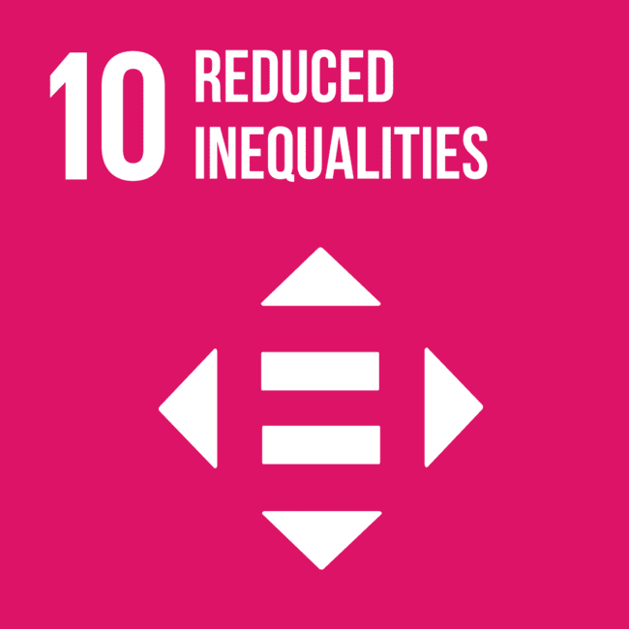
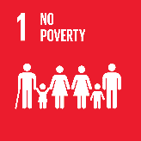
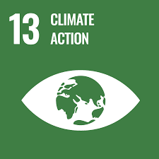
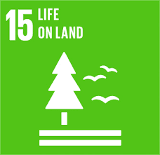


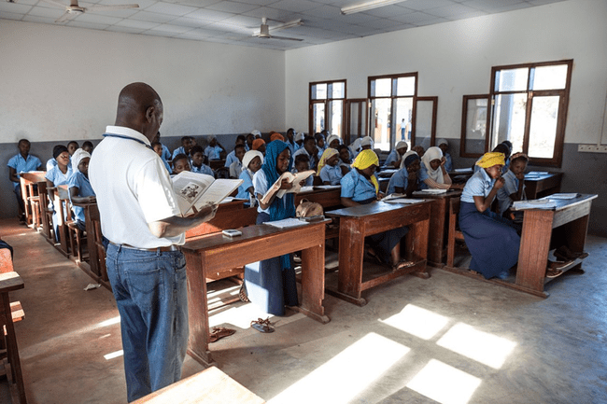
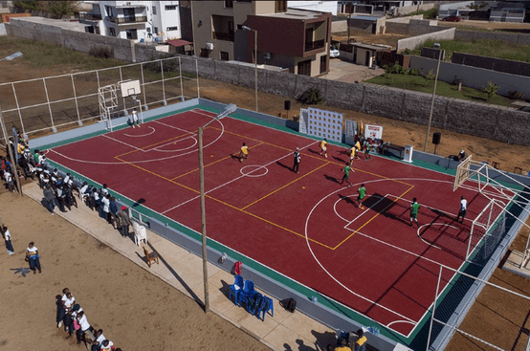
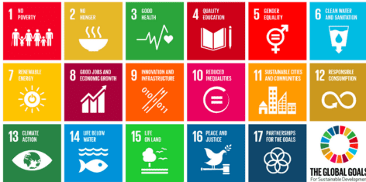
Eni Distinctive Approach
Sustainability Plan
To support the socio-economic development of Mozambique through implementation of Local Development Programs in line with the Government's strategic plans and UN Sustainable Development Goals
Main Intervention Areas
Education
Clean Cooking - ICS
Pro-resilience
Emergency response
Local Content
The Local Content strategy focuses on the following pillars:
Development of local workforce
Development of local companies
Socioeconomic Development
10
Notes:
Jointly with Area 4 Partners, Eni is creating partnerships in Mozambique to develop several programs aligned with the UN SGD (17 SDG in the table on the right).
the main initiatives in place in Mozambique are:
For access to Education in Pemba we already completed Hard Activities such as School construction, Canteen and multi-purpose field.
Currently are in place the soft activities as Nutrition (school meals), Teacher training, extracurricular activities, adult literacy.
With this project, we achieved the following numbers:
Kindergarten: about 300 children, 16 educators, and 5 administrative staff.
Primary School: 57 teachers, 5,000 students (6 to 18 years old); Literacy: up to 400 adults from the Paquitequete district
About the access to Energy, Eni is implementing the Clean Cooking Project with the production of improved cookstoves.
This project contributes to the reduction of CO2 emissions, deforestation and respiratory diseases and create employment and small business opportunities.
We already completed the 1st phase in which we distributed 10.000 cookstoves for 50.000 people.
Currently the second phase is ongoing, in which we will produce and distribute additional 10.000 cookstoves; at the end of the 2nd phase the total number of beneficiaries will be 100.000 people.
We are implementing a Pro-Resilence Project that in Mecufi district.
The overall objective is to strengthen the resilience of local communities to the affects of climate change.
The main activities of this project are:
Replanting of 10 hectares of mangrove
promoting agro-ecological technique and recovery 40 hectares of area degraded
Constructing 11 water wells, rehabilitating 2 water well and 5 blocks of latrines for 5 primary schools.
Currently the status of the project are:
- 6 potential sites for seedling of mangrove,
- 5 agro-ecological fields identified
- geophysics survey activities for 11 drilling water well commencement.
For Emergency response we identified initiatives to contribute to awareness, prevention, and food support on Covid-19, including vital assistance for internally displaced persons (IDPs*)
With these activities we already achieved:
More than 3,500 elementary school students in Paquitequeque
5,000 families living in the Paquiteque neighborhood
150 families (750 people) benefited with Food Baskets
Approximately 56,000 IDPs

Slide 11
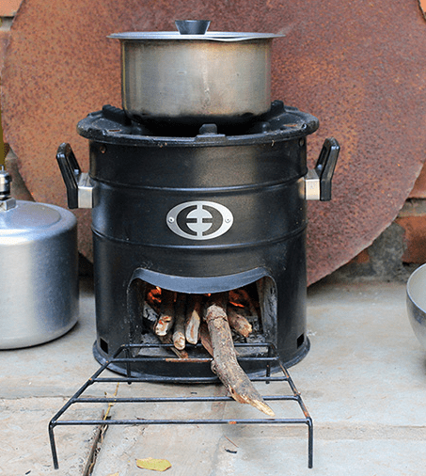
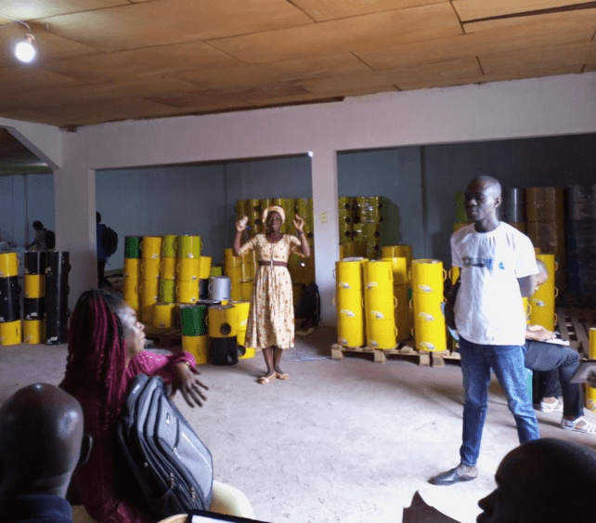
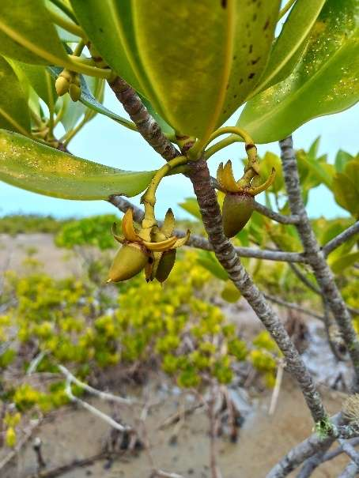
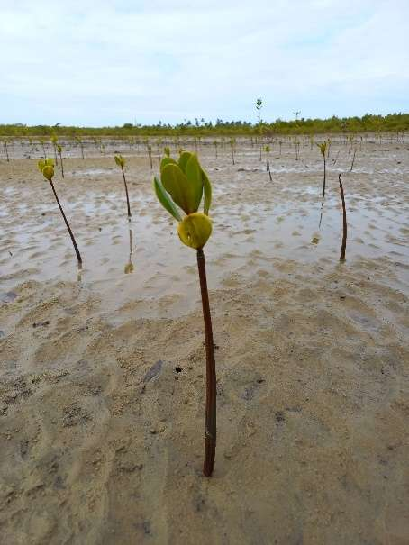
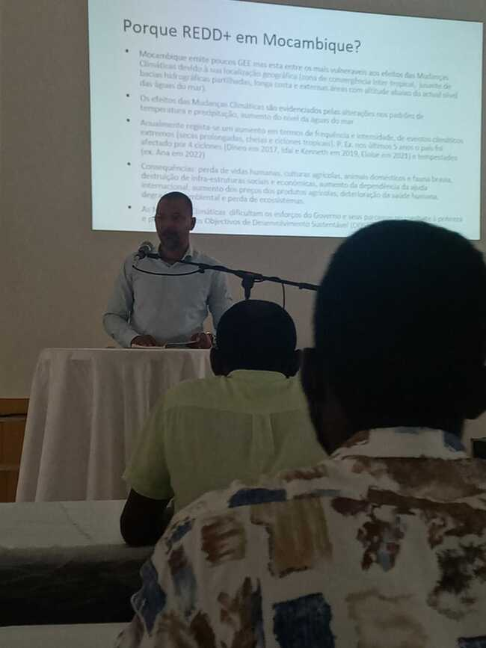
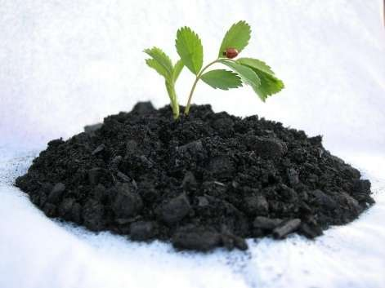
Carbon Offset Initiatives
Nature Based Carbon Offset
Technology Based Carbon Offset
  REDD+ Projects implementation
  Improved cookstoves: Safer and higher energy efficiency alternative to be distributed in Chimoio and Sofala, contributing to CO2 emission reduction
  Protect, conserve up to 3 Mha on Great Limpopo trans frontier conservation area
  Community benefits extend to about 500 K people
  Biochar: by-product of the Biofuel feedstock plant made from the waste of oil extraction process
Protect, conserve and restore up to 80Kha of degraded mangroves in the province of Sofala
11
Notes:
GENERAL:
As part of Eni’s business model towards carbon neutrality by 2050, Eni is envisaging in Mozambique to work towards two type of Carbon Offsetting/Mitigation initiatives
The first category of initiatives are “natural based” carbon offset, related to REDD+* Projects
In 2019 Eni has signed a MoU with the Mozambique Government that has been subsequently signed by the Minister of Mineral Resources and Energy (MIREME) and the Minister of Environment and Rural Development (MITADER)
The scope of the agreement is ongoing and aimed to perform a feasibility study and assessment of the Great Limpopo Trans-Frontier Conservation Area and Sofala Province
The feasibility study is on track and to be completed by 2022 and shall allow the start of the implementation of the REED+* projects by 2023
Particularly for Limpopo, the target is to protect and conserve up to 3 millions hectares which should allow carbon credits generation start by 2024 end [Optional: ramping initially from 1 million tons CO2 equivalent per year targeting to reach up to 3 million tones CO2 equivalent per year]
Instead for Sofala Province, the target is to protect, conserve and restore between 60-80K hectares of degraded mangroves. Such target should allow carbon credits generation by 2024 end [Optional: for up 0,3 millions tons, ramping up to 500 thousands tons CO2 equivalent per year]
In return these initiatives shall also benefit around 500 thousands people of the surrounding communities
*REDD stands for "Reducing Emissions from Deforestation and forest Degradation”; the “+” signifies the role of conservation, sustainable management of forests and enhancement of forest carbon stocks.
In the second half of the slide, you can see the second category of initiatives we are foreseeing in Mozambique, which are more “technology based” carbon mitigation projects
In particular Eni is working towards providing improved cookstoves to local communities, switching to safer, more efficient and less GHG emitting cooking devises.
This project shall start its implementation phase by first quarter 2023 and Eni is targeting to distribute up to 100,000 Stoves benefiting equally thousand Families
The Areas of interest in which this project would be implemented are Chimoio and Sofala province
[Optional: This project shall contribute around 1,2 millions CO2 equivalent per year]
Biochar:
Another "Technology based carbon" mitigation intiative that Eni is foreseeing in Mozambique is the production of Biochar
The Biochar can be used as means of sequestering carbon and improving soil quality too; [Optional: biochar this is a carbon-rich organic material that can be derived by pyrolysis under high-temperature and low-oxygen conditions of the cake produced as waste from the Bio-feedstock Oil Extraction process]
The plan for producing Biochar is embedded as a by-product within the plan for the Biofuel Feedstokes initiative (Agri-hub program) that I will brief in next slide
REDD+ Projects Highlights
MoU between Eni SpA and MIREME
MoU on Sustainable Development Goals (SDGs) signed in 2019 with 2 years validity
Extension of MoU up to 2023
REDD+ Feasibility Study started in August 2021 and targeted to end in October 2022
Project implementation would start at the beginning of 2023
Limpopo: protect/conserve over 3M ha. First carbon credits generation expected at the end of 2024, for an amount of 1M tons per year ramping up to over 3M tons per year on the full project area. Community benefits generated by REDD+ could extend to about 0.5M people
Sofala: protect/conserve and restore 60-80K ha of degraded mangroves. First carbon credits generation expected at the end of 2024 for about 0,3M tons, ramping up to 0.5M tons in the following years
Cookstoves Project highlights:
Project kick off: Q1 2023 with first distributrion of 100,000 Stoves benefiting around 20-40 KFamilies
Cookstoves distributed ≈ 100.000 (planned)
Carbon credits generation ≈ 1,2 M VCUs (same in Tons)
First carbon credits retirement ≈ 75 k VCUs (Q3 2024)
NGO implementing actor
Ares of interest Chimoio e Sofala province
Biochar highlights:
Biochar is a carbon-rich organic material, an organic amendment, and a by-product that can be derived from biomass by pyrolysis under high-temperature and low-oxygen conditions. Biochar can be used as means of sequestering carbon and improving soil quality.
The plan for Biochar is embedded within the Biofuel Feedstocks initiative (Agri-hub program) which partially use the wastes from oil extraction process to produce Biochar. The production volumes and potential GHG contribution are to be defined together with the feasibility study of the agri-hub program

Slide 12
Conclusions
  Eni is working to build a long-lasting partnership with the Republic of Mozambique, contributing to the production of its natural resources through its longtime experience and recognized capabilities, while keeping a sharp focus on the energy transition, fostering the diversification of the local economy and working with stakeholders and leveraging local content to create conditions for a common growth.

Slide 13
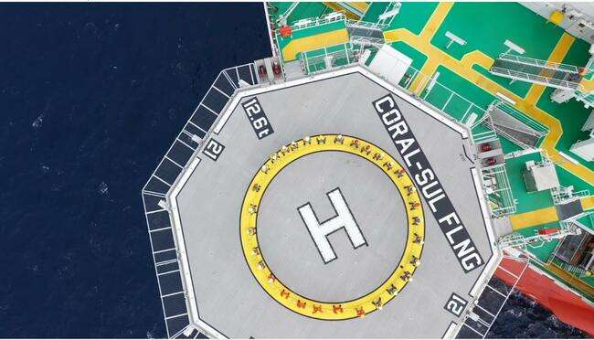

Thanks to the People of Mozambique.

