Slide 1
Financing the Expansion of Mozambique’s Energy Sector:
- The Role of Sovereign Funds
Mozambique Energy Summit - 2022
By: Inocência Mapisse
2022

Slide 2
1. Presentation Structure
General Overview of Energy Sector;
Economic Management Instruments – Strategic Objectives;
Banks & SWF as Source of Financing;
Top 5 sectors investments of SWF;
Moz SWF budget and profile;
Final Considerations.

Slide 3
1. General Overview of Energy Sector
World
Nowadays, O&G companies are reinventing themselves by:
  Practicing capital discipline;
  Focusing on financial health;
  committing to climate change and;
  Transforming business models.
Among the main objectives of this strategy are:
  Streamline and optimize their resource portfolios;
  Embrace and develop smart goals for the energy transition;
  Attract, train, and retain employees in a tight labor market;
  Come to terms with additional environmental, social, and governance requirements.
Mozambique
The country targets to reduce GHG emissions by 20% in 2025 under condition of international support.
Companies:
  Total Mozambique - target of a 40% reduction by 2030 in our net Scope 1+2 emissions compared to 2015 is in line with the commitments made by countries with a net zero pledge, including the European Union with its "Fit for 55" package; (S&C Report progress, 2022)
  ENI - Coral-Sul FLNG was implemented with an energy optimization project, integrated in the midst of a systematic analysis of energy efficiency optimization. (ENI, June 2022)

Slide 4
2. Economic Management Instruments – Strategic Objectives
SDG – Goal 17 – Affordable, reliable, sustainable, modern and clean energy;
PQG (2020 – 2024):
  The Energy sector will focus on the expansion of the National Electricity Network (REN), the increase in energy availability, through public and private investments with an increasing contribution from renewable energies – 64% of pop with access to energy;
  Promote the extraction of minerals and hydrocarbons, ensuring their sustainability - Increase in gas production (millions of tons/year) for the implementation of industrial and LNG projects – to 15 Mton/year until 2024;

Slide 5
3. Banks & SWF as Source of Financing
SWF’s have different types of purposes (stabilization function, savings, financing, diversification, development and strategy);

Slide 6
3. Banks & SWF as Source of Financing (Cont.)
SWF as source of financing | Arguments
Characteristics of SWFs (i.e. inter-generational nature, medium- to long-term investment horizon, higher tolerance for risk) = well-suited to supporting green investments - green infrastructure projects. | Increase climate change shocks (IDAI, Kenneth, etc)
SWF is a transparency management tool | Concrete steps need to be taken to develop fiscal rules that facilitate decarbonisation and long-term strategies to support the SDGs, promote improved transparency that allows stakeholders to scrutinise and pressure fund managers, build stronger internal investment capacities to develop and execute sustainability strategies, and apply pressure to other investor groups and portfolio companies
tangible investment goals for SWF | SWFs can develop tangible investment goals and strategies to be operationalised by integrating relevant criteria into portfolio processes and allocation decisions – which will require resources dedicated to data collection, analysis, and communication – or by joining sustainable investment platforms.

Slide 7
4. Top 5 sectors investments of SWF
Source: Fletcher schools at Tufts University, 2022

Slide 8
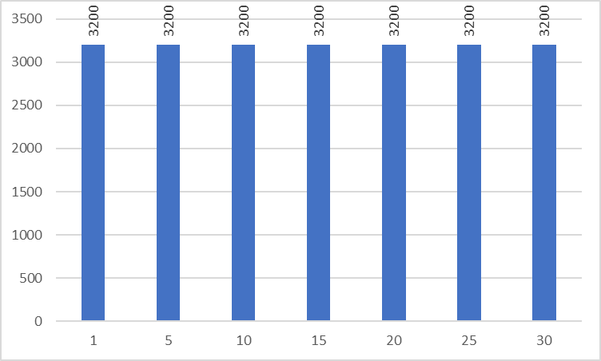
5. Projecctions of Annual Moz SWF budget (thousand USD)
126,6% of budget deficit - 2022
Source: author

Slide 9
6. Profile of the SWF in Mozambique
SWF Mozambique
Saving & Stabilization
Structure (Parliament, MEF, BM, Managers); Rules (entry and exit,
Development (investment in infrastructure)
State budget

Slide 10
Entry Rules
Until Year 20 – 50% to State Budget; 50% to SWF (S&S)
From year 21 – 20% to State budget
Exit Rules - Investments
Through the state budget

Slide 11
7. Final Considerations
Adjust Mozambique SWF
Prioritization of the sovereign investment fund;
  Reinforce the rules (entry and exit);
  Define the Investments policy;
  Quantify the needs in terms of investments (include green investments)

