Slide 1
Southern African Power Pool Project Advisory Unit REGIONAL ENERGY PROJECTS 15 September 2022

Slide 2
Presentation Outline
SAPP Project Advisory Unit
SAPP Regional Projects Landscape
Mozambique – Zambia Transmission Interconnector Project
Mozambique – Tanzania Transmission Interconnector Project
Mozambique – Zimbabwe Transmission Interconnector Project
Technical Assistance

Slide 3
1.0 The SAPP Project Advisory Unit (PAU)
Who We Are
The SAPP PAU was established in 2015 under the World Bank Program for Accelerating Transformation Energy Projects (AREP).
Programmes Manager
Project Specialist (2)
Communication Specialist (1)
Environmental Specialist (1)
Procurement Specialist (2)
Chief Transaction Advisor (1)
Office Administrator
(1)
Accounts Officer (1)

Slide 4
1.1 Role of the SAPP-PAU in Project Coordination
What We Do
Identify a pipeline of generation & transmission projects in line with the SAPP Pool Plan (2017)
Assess market-readiness and prepare project concept together with Utilities
Evaluate technical & financial resources required for project preparation, transaction support, financial structuring
Draft terms of reference for consultancy services
Solicit for funding from various cooperating partners
Work with the SADC Secretariat to ensure Governments commitments (IGMOU).
Through IGMOUs we facilitate for inter-utility agreements (IUMOU).
Provide Fiduciary support for project preparation and structuring.
Plan and coordinate Project implementation.

Slide 5
2.0 SAPP Regional Projects Landscape
Legend
No. | Project Name | Status
1 | Mozambique-Malawi Line | In Construction
2 | Angola-Namibia Line | Feasibility study completed
3 | ZIZABONA Lines | Feasibility study completed
4 | Alaska-Sherwood Line | Feasibility study completed
5 | Zambia-Tanzania Line | Feasibility study completed
6 | Kolwezi-Solwezi Line | Feasibility study completed
7 | Mozambique-Zambia Line | Feasibility study completed
8 | Botswana-South Africa Line | Feasibility study completed
9 | Baynes HPP + Lines | Procurement of Consultants
10 | Malawi-Zambia Line | Contract Negotiations Started
11 | Mozambique-Tanzania | Pre-Procurement of Consultants
12 | Inga-Soyo Line | Pre-Procurement of Consultants
13 | Mozambique-Zimbabwe Line | Project Concept Stage
14 | STE Lines (Mphanda Nkuwa) | Contract Negotiations Started
15 | Luapula HPP + Lines | Pre-Procurement of Consultants
G
Hydropower Plant
G
Gas Fired Plant
G
Diesel/Coal Fired Plant
DRC
Tanzania
12
G
5
G
15
G
11
6
G
Angola
G
10
2
G
Zambia
7
Mozambique
Malawi
G
G
G
G
4
G
9
Zimbabwe
1
3
G
14
Namibia
Botswana
13
G
8
Eswatini
South Africa
Lesotho

Slide 6
3.0 Mozambique – Zambia Transmission Interconnector Project
ZESCO Network
400kV
Chipata West
Substation
375km Line
400kV
Matambo
Substation
EDM Network

Slide 7
3.1 Mozambique-Zambia Transmission Interconnector Project
Project Objectives and Goals
To increase regional power flows and trade within the SAPP region by accelerating supporting infrastructure (transmission capacity) within the SAPP that can be used to facilitate both the Day Ahead Market (DAM) and bilateral trading arrangements.
Provide transmission infrastructure to cater for future grid interconnections to other EAPP and SAPP countries.
Increase diversity of generation resources resulting in increased system resilience in the wake of climate change

Slide 8
3.2 Mozambique-Zambia Transmission Interconnector Project
Feasibility Studies
Feasibility studies coordinated by SAPP using NEPAD IPPF funds (US$1.4 m) and World Bank AREP funds (US$463,300). Utilities also made financial contributions
Studies undertaken by AF Consult (AFRY) of Switzerland
Studies completed
System Studies
System studies conducted for different scenarios
Energy flow across interconnector investigated through an energy model developed for the entire SAPP system.
The utilisation of the interconnector is above 50%
Project Economics
Project is economically viable
Project has NPV of US$214.5 m at a DF of 10%
Project IRR is 18%
Technical Definition
Project infrastructure scope developed
LiDAR survey and Geotech carried out for entire line and substation locations
ESIA
ESIA studies coordinated by SAPP using NEPAD IPPF (US$561,349) and World Bank AREP funds (US$150,146)
Studies completed. ESIA for Mozambique approved while that for Zambia is being revised to include comments from the environmental authority

Slide 9
3.3 Mozambique-Zambia Transmission Interconnector Project
Infrastructure Scope & Cost
Transmission Lines
Matambo Substation (Mozambique) – Chipata West Substation (Zambia) 2x 400 kV single circuit Transmission Lines (375 km of which 75% is in Mozambique)
Substations
Extend Matambo Substation
Install 1 x 400/220 kV Autotransformer
Install +100/-100 MVAr STATCOM
Extend Chipata West Substation
Install 2 x 400/330 kV transformers
Project Cost
Project CAPEX estimated at about US$411 m shared US$279 m/ US$132 m between Mozambique and Zambia

Slide 10
3.4 Mozambique-Zambia Transmission Interconnector Project
The Mozambique – Zambia Interconnector introduces a new power flow connection path in SAPP and therefore contributes to relief of congestion
Project has a net economic benefit to the region
Interconnector utilisation demonstrated to be above 50%
Additional funding required for preparation of tender documents (approx., US$250k)

Slide 11
4.0 Mozambique – Tanzania Transmission Interconnector Project
TANESCO Network
400kV
Mtwara
Substation
200KM Line
400kV
Palma
Substation
EDM Network

Slide 12
4.1 Mozambique – Tanzania Transmission Interconnector Project
The Project is for the Feasibility and ESIA studies of a proposed 200km, 400kV transmission line between Palma substation in Mozambique and Mtwara substation in Tanzania.
Feasibility and ESIA studies are funded by the NEPAD-IPPF. – US$1.99m
Beneficiary contribution from EDM & TANESCO approx. US$110k
IGMOU signed while revised IUMOU being finalised.
TORs for technoeconomic studies and ESIA have been prepared
Procurement of consultants to commence by Q4/2022

Slide 13
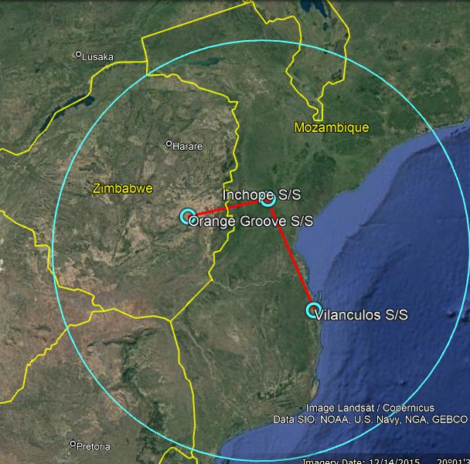
5.0 Mozambique – Zimbabwe Transmission Interconnector Project
ZESA Network
400kV
Orange Groove
Substation
185km Line
Inchope
Substation
400kV
EDM Network
350km Line
400kV
Vilanculos
Substation
G
450MW
Temane GPP

Slide 14
5.1 Mozambique – Zimbabwe Transmission Interconnector Project
The Project is at Concept design stage.
The Project is a for a technical feasibility and ESIA study for the proposed 350km, 400kV line between Vilanculos (Mozambique) and Inchope (Mozambique) and a 185km, 400kV line from Inchope substation to Orange groove substation (Zimbabwe).
Integration of the proposed 450MW Temane Gas Fired Power Plant to the Mozambique and Zimbabwe electricity networks for power evacuation to markets.
Project outputs include a techno-economic feasibility study report, an ESIA study report and tender documents.
Strengthen interconnection of Mozambique to the SAPP network.
Contribute to increased access to affordable energy.
Contribute to regional electricity markets and power trading.
Contribute to improved in-country and regional security and reliability of electricity supply.

Slide 15
5.2 Mozambique – Zimbabwe Transmission Interconnector Project
Drafting of Project Concept note completed.
Drafting of Technical and ESIA TORs completed.
Review of IGMOU, IUMOU and mandate letter ongoing.
Financial planning for project preparation funds cost estimate is ongoing.
Funding agreement not yet closed.

Slide 16
6.0 Support to Regional Energy Stakeholders
Technical Assistance
Mozambique (GMNK):
Support to the Mphanda Nkuwa HPP transmission lines development Project:
Procurement Support: Overall management of the procurement processes for the procurement of Consultancy services.
Transmission Planning Support: Support to the procurement of techno-economic study consultancy services.
Markets Analysis Support: Support to the procurement of a market study consultancy service.
ESIA Support: Support to the procurement of ESIA study consultancy services.
Angola-Namibia(The Baynes HPP PJTC):
Development of TORS and procurement of five experts to constitute an Independent Panel of Experts (IPoEs).
Development of TORs and procurement of a Resettlement Action Plan (RAP) Expert.
Development of TORs and procurement of a RAP Expert.

Slide 17
Thank you!

