Slide 1
Digital
How Digital bridge Progress of Mozambique
Hussein Ibrahim Hamed
Africa Vice President – Energies and Chemicals
Schneider Electric

Slide 2
The only Approach for Countries / sites with High emission brown field
3-steps approach covering 3 tiers of decarbonization measures
DIGITIZE
STRATEGIZE
Low hanging fruits
relying on energy efficiency, digitization
typical CO2 benefits up to 25%
DECARBONIZE
Paradigm change in your design
eg Electrification +PPA, unmanning typical CO2 benefits 25% to 100%
Major projects
eg Green H2, CCUS, deploy your own renewable farm+ storage
achieve your CO2 reduction target
Notes:
How we reach the Net zero having legacy of structured Supply and Demand in mature and developed countries, with large and distributed installed sites with emissions reduction strategy not integrated from the CAPEX phase
They need to follow 3 steps:
Baseline assessment: Emissions, decentralized electrical distribution etc…
Prioritize
Implement
Need heavy investment to decarbonize, despite Low hanging fruits which bring up to 25% CO2 benefits, yet we have 75% of the impact which need large investment.
This is only to cover the brownfield. Any new projects need to be green
However in a scenario where
How to avoid the 1st scenario
What would be the approach to follow in the case of building a green country or implementing a green project?

Slide 3
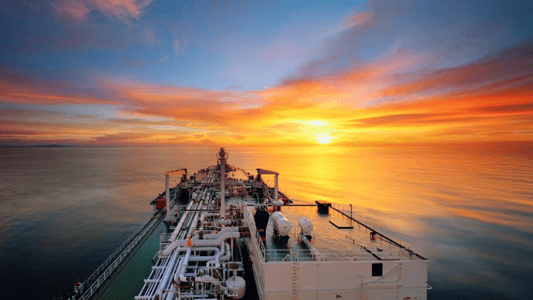
Grow with Net Zero instead of later decarbonization
Strategy for building green Country
Enabling Technologies
Supply:
Multiple Distributed –Renewables
Gray – Only centralized (one large Gas PP)
Demand:
Avoid small site emission everywhere
All Electrical ecosystem
Incase promote microgrids with prosumers model to have net zero on site level
Intergated digitalization Electrification
Carbon Capture Utilization & Storage
New energies: Hydrogen, Wind, Solar, EV, Biofuel, etc…
Net Zero
Digital
Supply
Demand
One way
Notes:
Build a green country
Multiple diffused sites ➔ need to decarbonize (Generation // Demand side)
What should be done to rebuild the countries toward net zero:
No compromise on small diffused emissions (supply / demand) ➔ Electrical (supply=distributed generation ➔ renewables, // consumption: all electric)
➔ Digitize for remote monitoring. Load balancing, Power source optimization accross the full value chain
If compromise ➔ Should be centralized ➔ Decarbonize thru CCUS
Grow with Net Zero instead of later decarbonization thru digital
If you are greenfield country what should be done
Country pic with actual market segments landscape Vs Ideal country landscape

Slide 4
Future is:
Electrical
&
Digital
makes energy green
makes energy smart
Electricity is the most efficient energy and the best vector of decarbonization
Digital makes the invisible visible, measurable, and actionable
Notes:
Think of Electricity 4.0 as the ‘fuel’ for this New Electric world…. One which is more sustainable and more resilient. Here’s why…
Firstly, Electric makes energy green: Because Electricity is the most efficient energy (proven to be 3-5x more efficient than other sources) and it is also the best vector for decarbonization (6x electricity coming from solar/wind by 2040… from 6% today to 40% in the next 20 years… and electricity is expected to double it’s share of the energy mix in the same time frame)
Secondly, digital builds a smart future. It makes the invisible visible, driving efficiency and eliminating energy waste.

Slide 5
Digital
Four Integrations
+
New business
models
1
Energy
Automation
Efficient
Reliable operations
Process optimization & Sustainable Profit
2
End Point
Cloud
EcoStruxure Power and Process
3
Design & Build
Operate & Maintain
Electrification
Energy Transition
Integrated
Company Management
4
Site-by-Site
Power
Process
Agile & Empowered
Workforce

Slide 6
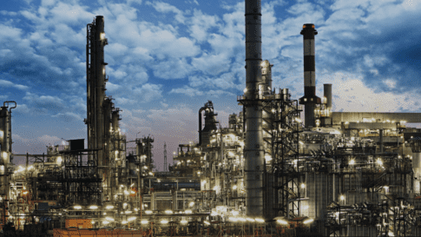
Our purpose is to empower all to
make the most of our energy and resources
bridging progress and sustainability for all.
Our mission is to be your digital partner for
Sustainability and Efficiency
At Schneider, we call this

Slide 7
Notes:
Closing slide

