Slide 1
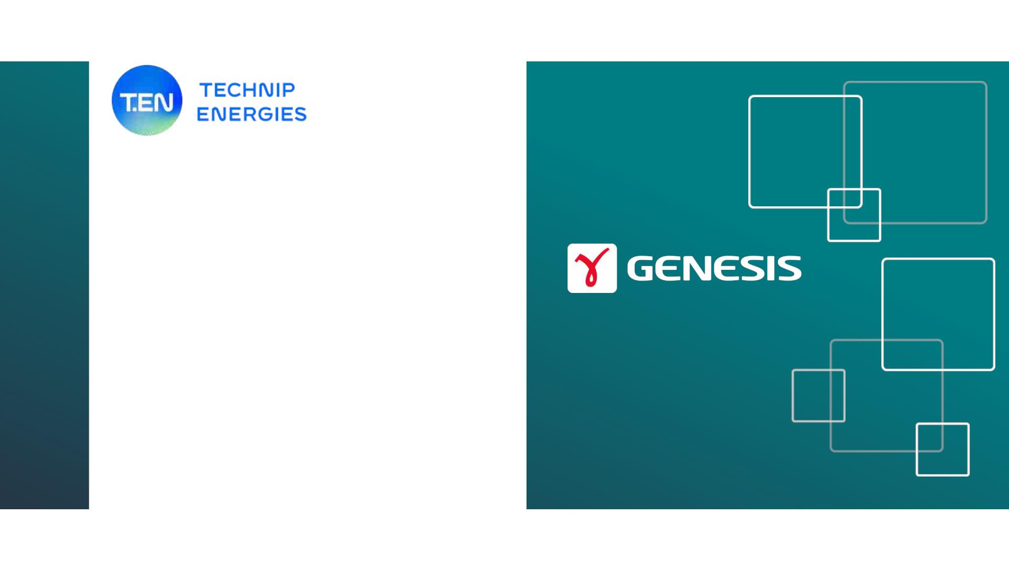
Technip Energies &
Genesis
Strategic Decision Making
How to make the right technological
investment/ project decisions to reshape
MOZ Energy Landscape?

Slide 2
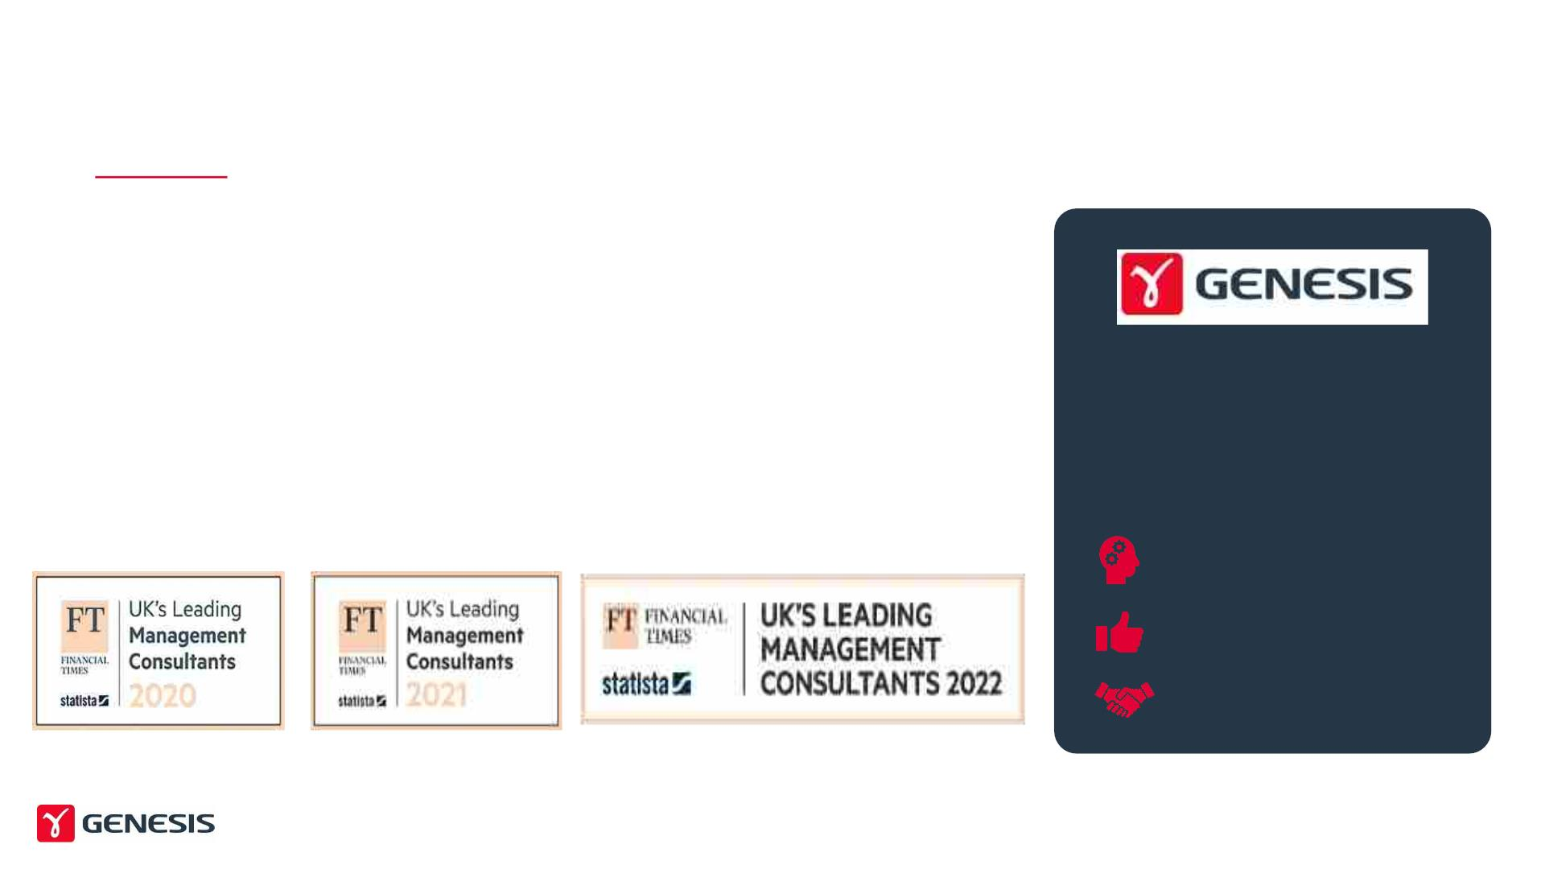
Who are we?
Providing Deeper Understanding to Energy Companies since 1988
Genesis is a market-leading advisory company providing
technical and consultancy services to the global energy industry.
Genesis is committed to facilitating the journey to net zero and the
path forward to sustainable global energy.
Your trusted advisor on the
journey to a sustainable future
We help clients navigate risks and leverage opportunities.
+32 Years Expertise
9.3/10 Customer Satisfaction
Trusted Partner with +70 MSAs
2

Slide 3


Slide 4
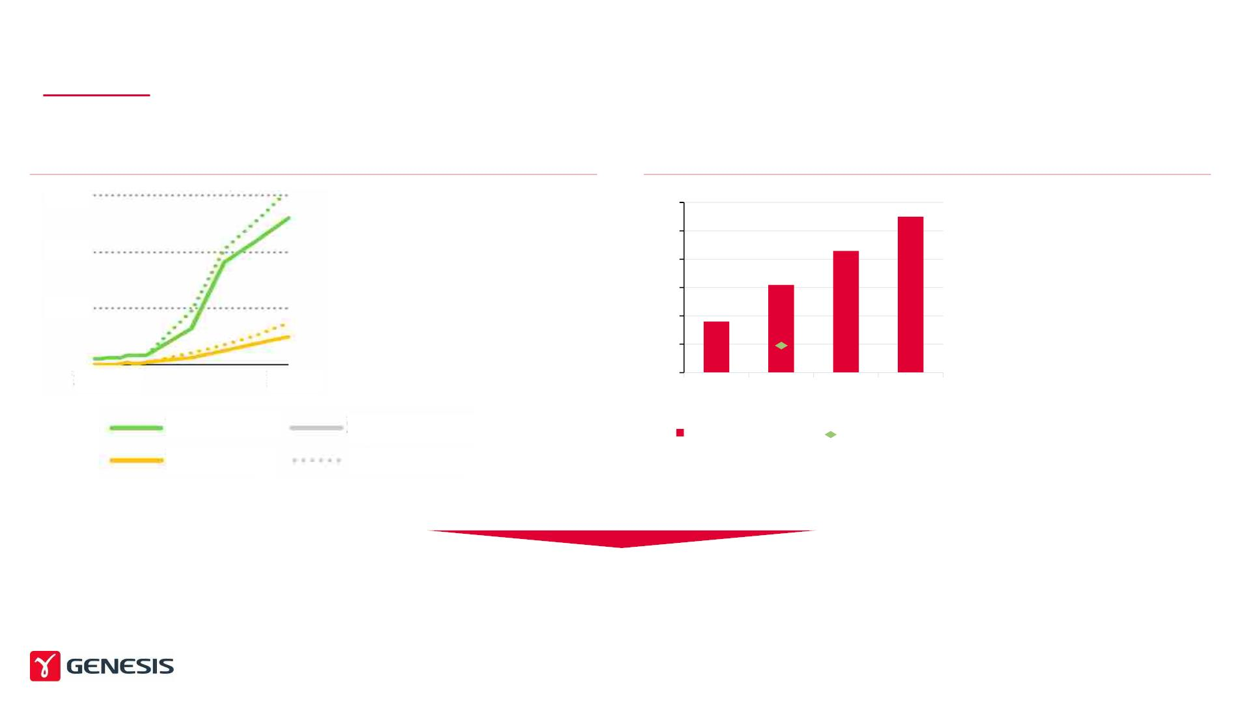
Mozambique is at an inflection point – The right technology investment
decisions will be critical in unlocking value
New Domestic Gas Production (BCM)
Huge increase in domestic
A growing population (million)
• Large Population increase
90
60
30
60
50
40
30
20
10
0
Gas Production
• Increasing need to
provide energy and
electricity
Continuous increase in
domestic gas demand in line
with population growth /
increased local access to
energy
• ~70% of population
without reliable access to
electricity (2019)
2010
2040
2000
2018
2030
2040
Production
Demand
Stated Policies
High Case
Population (m)
Population with Access
to Electricity in 2019 (m)
What technology investments can energy transformation, monetization and drive domestic
industrial development ?
Source: IEA Mozambique Energy Outlook 2019

Slide 5

In order to assess Technology Investment decisions we
need to be able to assess options across three variables
Strategic & Economic
• How does it fit into a wider economic (energy)
strategy?
• What is the real ROI?
Technical
• Is the technology mature?
• What is the optimal technological concept?
• How does it integrate?
Technology
Investment
Decisions
• Do we have offtake?
• How does it scale?
• What markets are products aimed at?
• How to transport? At what costs?
• Is the investment bankable, attractive?
• Green certificates, Loans or Grants?
License to Operate
• What impact can the project have on the local
economy? Local employment?
• How can impact be maximised?
• What is the multiplier effect on the economy?

Slide 6
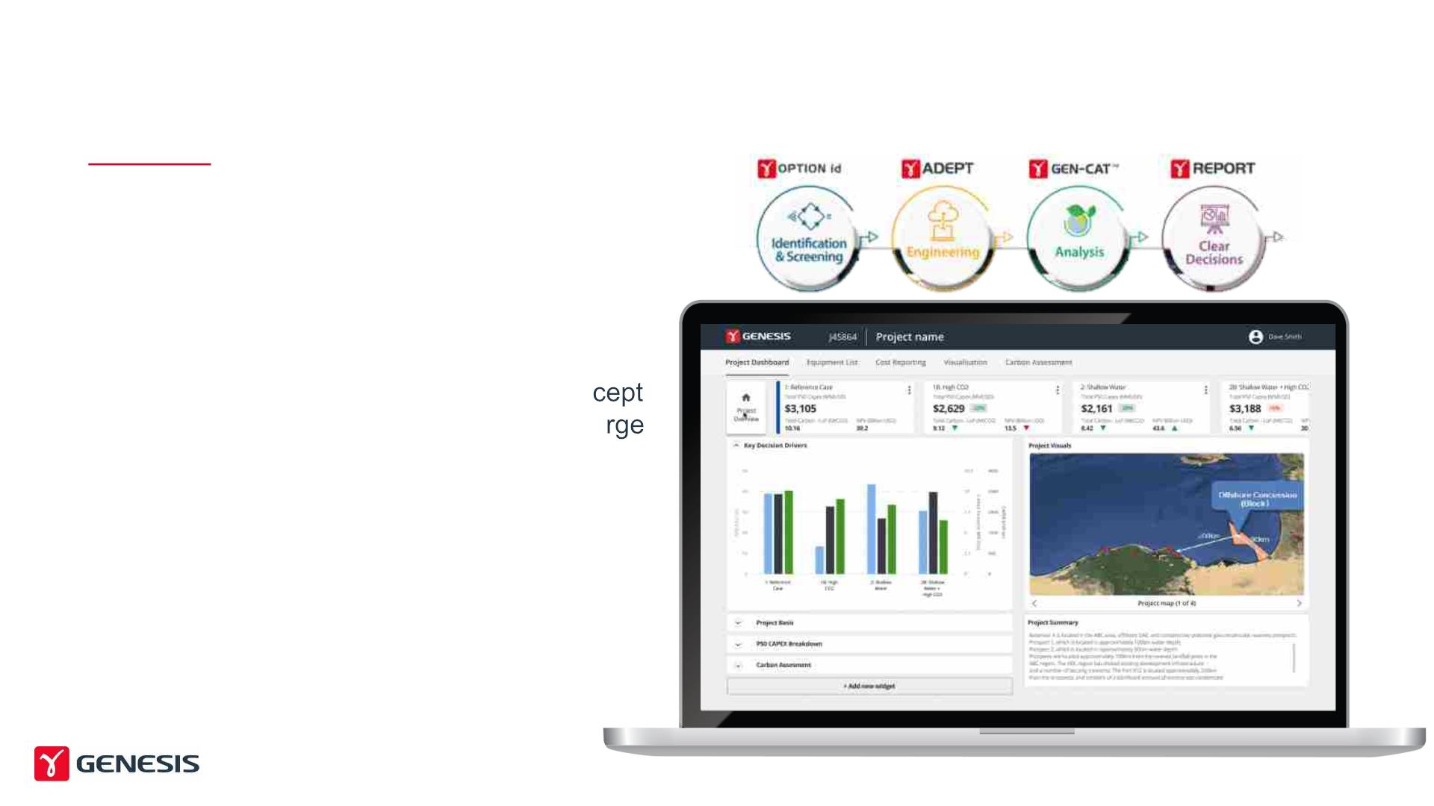
Techno – Economic Assessment requires strong Digital
Tools (e.g. UFE) to identify and optimize concepts
STRONG DIGITAL SUPPORT IS KEY
• Need to make efficient, transparent and
effective decisions early in the lifecycle
• For Techno-Economic evaluation and con
assessments of technology investments, la
amounts of data needs to be processed
• Near limitless combination of Options
• Technology concepts
• Plant sizes
• Economic assumptions
• CO2 footprint
• …
6

Slide 7
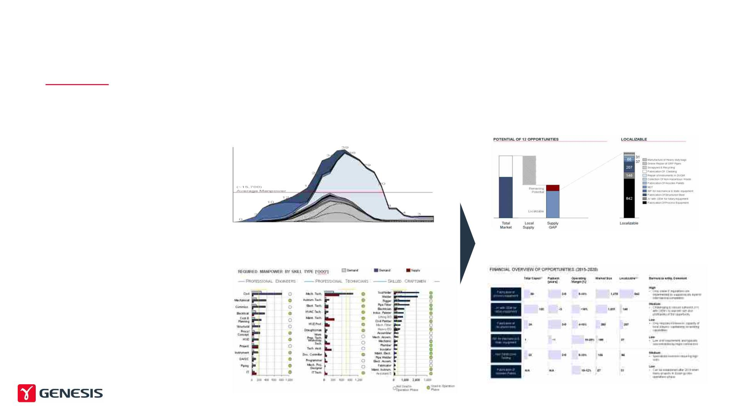
Any major technology investment needs to showcase its
value for the local population and the local economy
LICENSE TO OPERATE
MANPOWER & SKILLS REQUIREMENTS
SUPPLY CHAIN LOCALIZATION POTENTIAL
Manpower Requirements over time
Total Spend by category
§ Ensure that the ‘localization potential’
for any investment is understood
§ Human Capital/ Jobs:
§ Assess across EPC as well as the
Operations Phase
§ Breakdown by trade/ discipline
§ Supply Chain
– Assess total spend that can be
localised
Local Demand Gap by Discipline/ Trade
Category Assessment and Localisation Potential
– Assess by Category
§ Review possibilities to increase
localisation through
– Jobs: Training, education, etc., or
– Spend: Investment, volume
guarantees, loans, etc.
7

Slide 8


