Slide 1
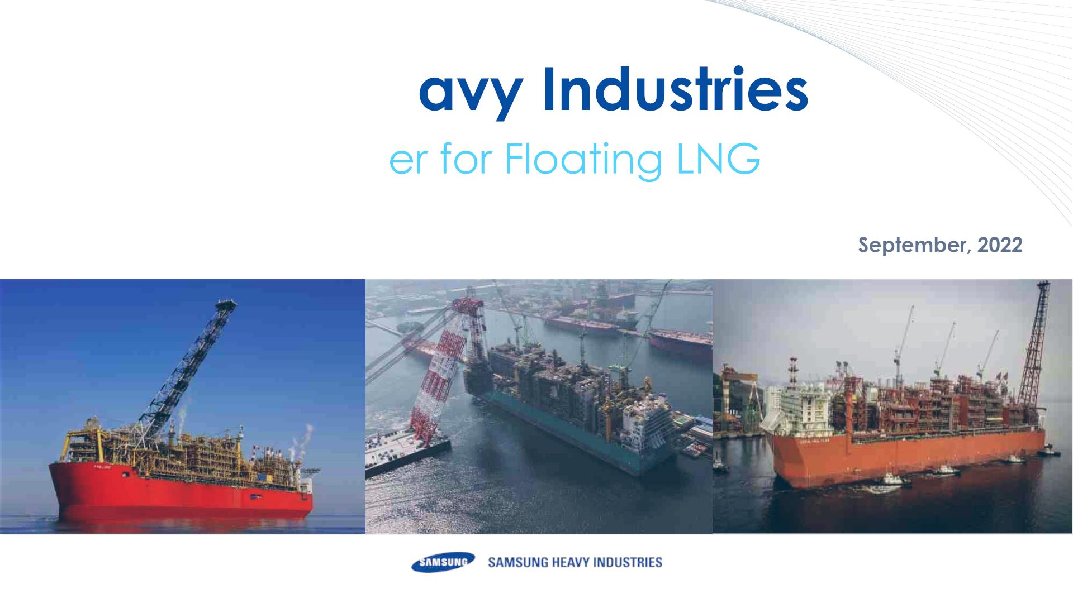
Samsung He
− Solution Provid

Slide 2

Table of Contents
1
LNG into Offshore
2
Preparing for Future FLNG
- New Needs : Nearshore FLNG
- FLNG Solutions with SHI
- FLNG Solutions in Mozambique
- Greener Solution for Offshore FLNG
3
Summary

Slide 3
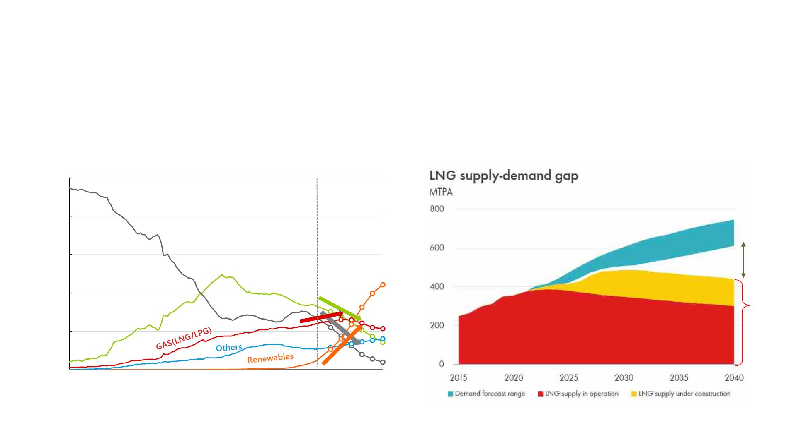
LNG into Offshore
Changing Energy Demand & Supply
- More LNG Facilities are needed to meet future demand
[Energy Demand Forecast]
[Energy Supply Forecast]
100%
80%
60%
40%
20%
0%
Demand
Gap
Oil
Coal
Under Construction
Supply
Production
1900
1915
1930
1945
1960
1975
1990
2005
2020
2035
2050
Source : BP energy outlook 2021
Source : SHELL LNG outlook 2022

Slide 4
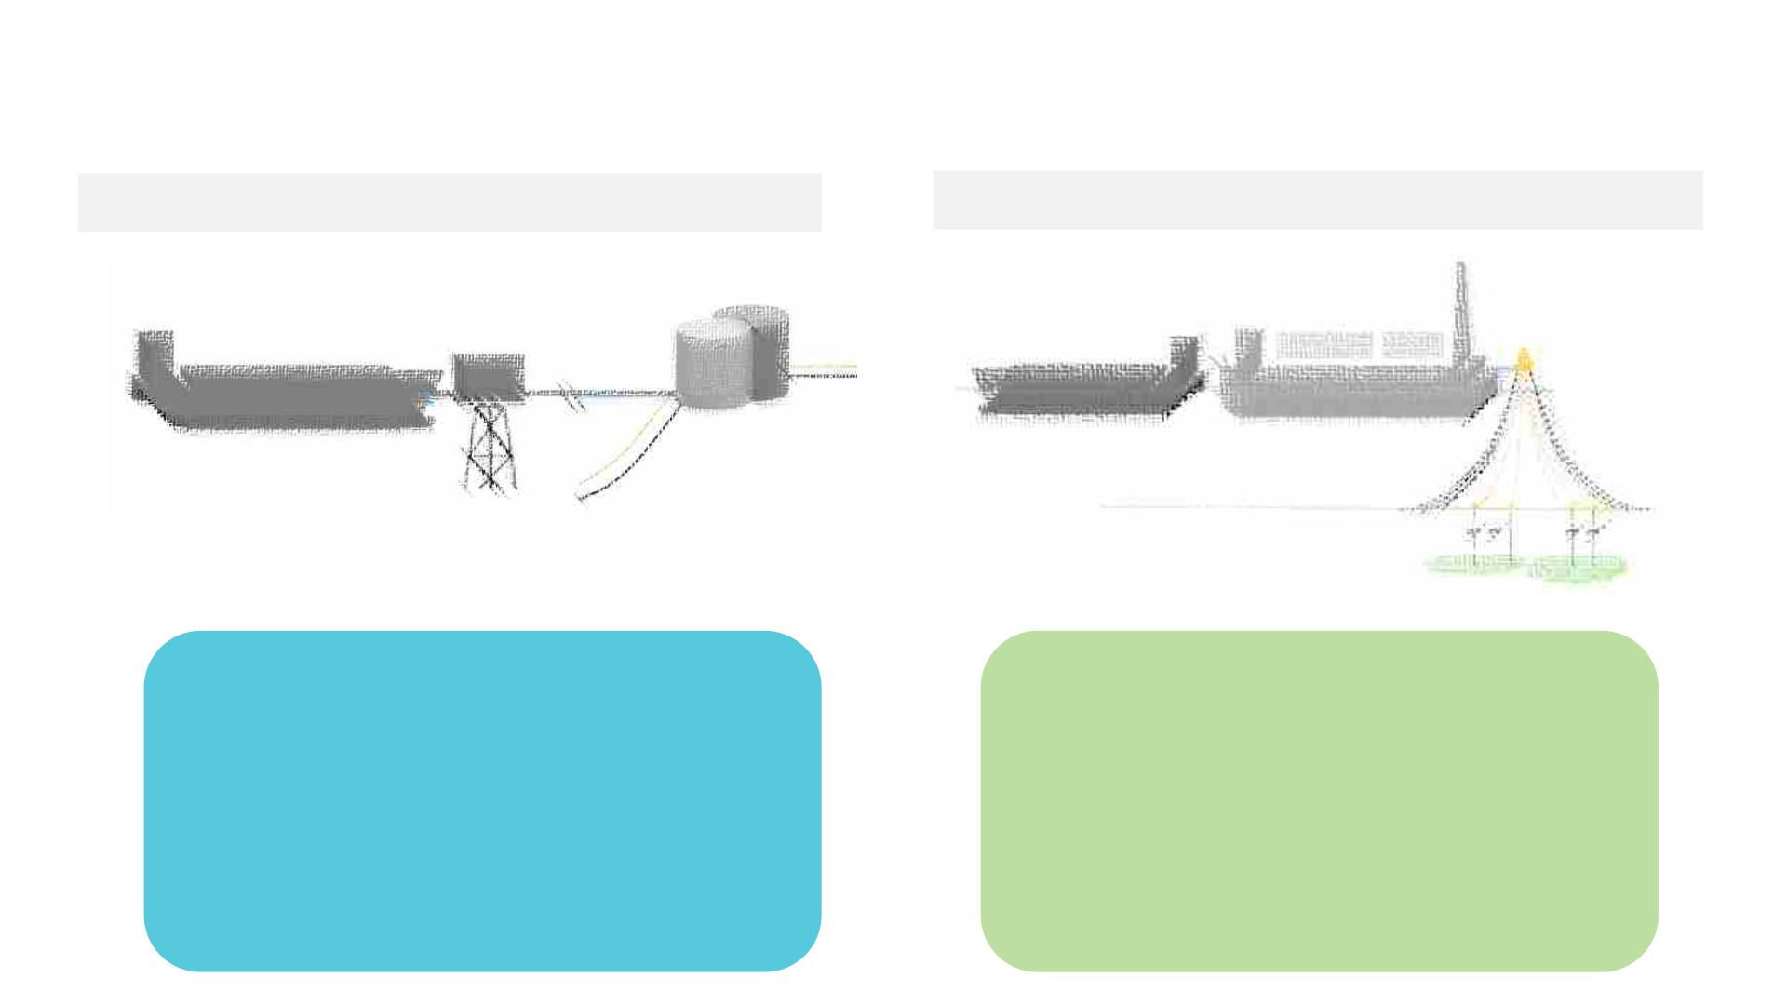
LNG into Offshore
Solutions for Offshore Gas Harvesting today
[Onshore LNG Plant with Pipe Line]
[Floating : LNG FPSO ]
Onshore Plant
No Onshore land
Involved
LNGC
LNGC
FLNG
L
LNG Pipe Line from subsea wells, <50km
Deepsea Wells, >100km
[Onshore LNG Plant]
[Offshore LNG FPSO]
• Pipe lines subsea
• Land Development
• Potential Geopolitical risk
• Expansion Possible – Large Plant
• Quay for LNG Export
• Eco-Friendly
• NIMBY free - Low Social Affairs
• Low de-commissioning $$ - Mobility
• Limited Footprint
• High CAPEX/OPEX

Slide 5
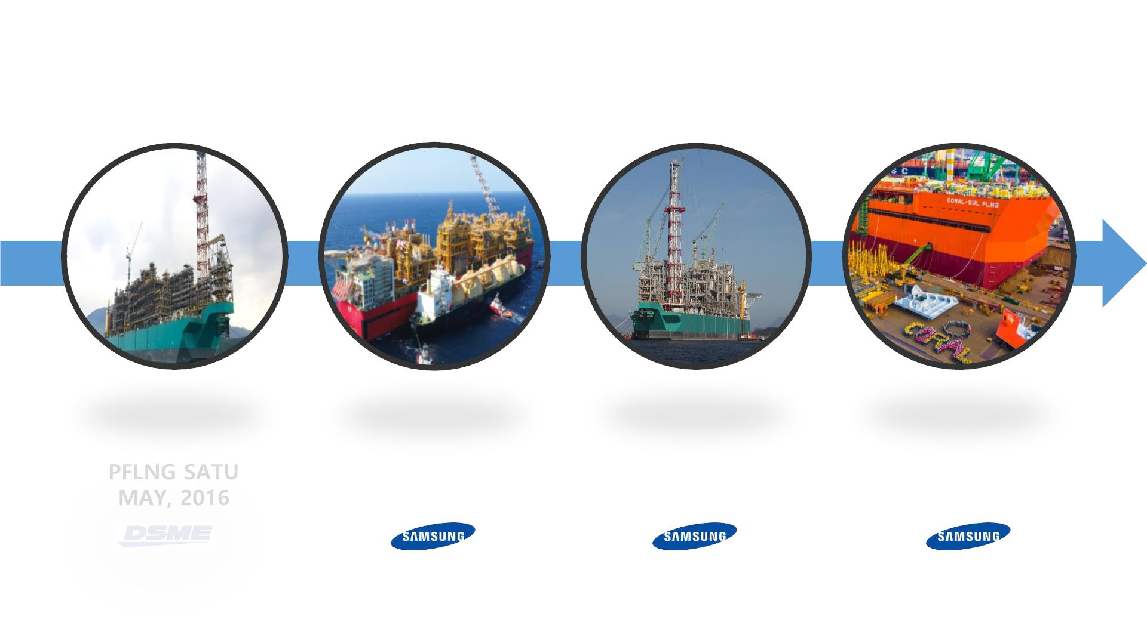
LNG into Offshore
FLNG Frontiers today
Source : mechademy.com
Source : Shell
Source : Petronas
Source : ENI
PRELUDE FLNG
JUN, 2017
PFLNG DUA
FEB, 2020
CORAL FLNG
NOV, 2021

Slide 6
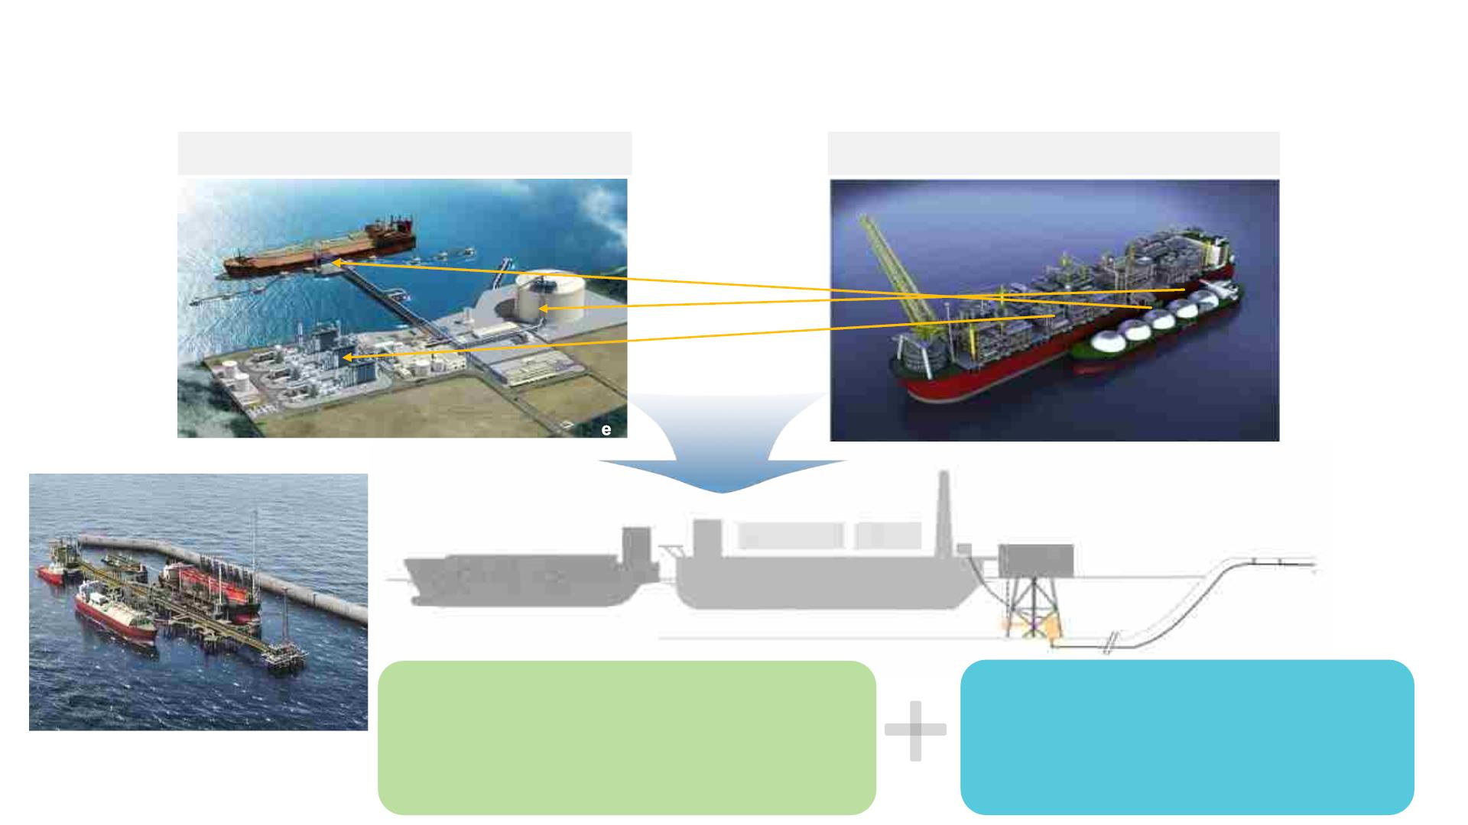
Preparing for Future FLNG
New Needs – Nearshore FLNG
[ Onshore LNG Plant with Pipe Line ]
[ Offshore LNG FPSO ]
LNGC
> 3.6 MTPA
LNG Pipe Lin
1 ~ 3.6 MTPA
Direct Wellhead
> 3.6 MTPA
Jetty Moored
FLNG
LNGC
FLNG
LNGC
• Small Land Development (Quay)
• Electric Driven (= Green)
• Larger Production Capacity
• Less CAPEX/OPEX
• Eco-Friendly
• NIMBY free
• Mobility
• No security
concern during
construction
Source : BP Golar Tortue
• Low de-comm $$
(No Living Quarter, Power Plant, Turret and Aux)

Slide 7
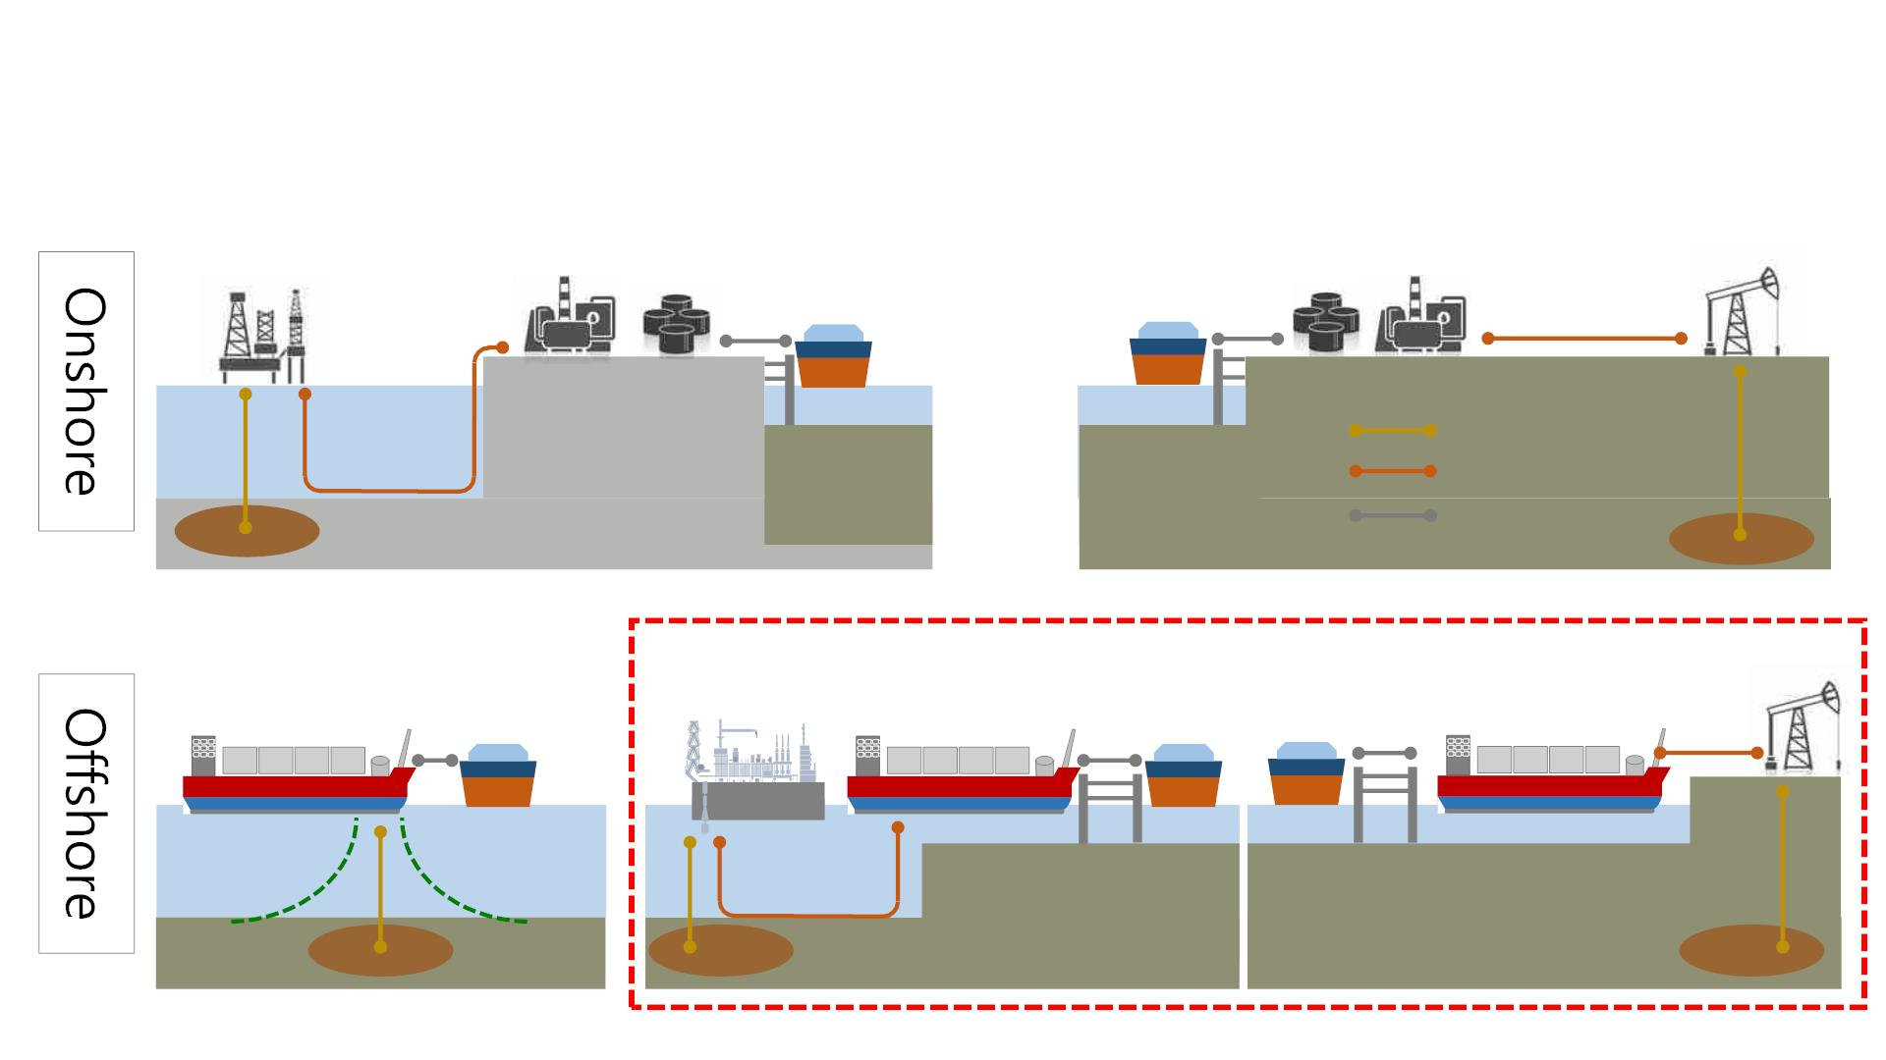
Preparing for Future FLNG
New Needs – Nearshore FLNG
* Production facilities selected according to field condition (FPSO, Platform, FPU, Subsea Production and so on)
Production &
Pre-treatment
Pipeline
Liquefaction
Storage
Offloading
Offloading
Storage
Liquefaction
Production &
Pre-treatment
LNGC
* Jetty Mooring
LNG
Pipeline Gas
LNG Transfer
Gas Well
Production & Pre-
treatment & Liquefaction
& Storage
Production &
Pre-treatment
Liquefaction
& Storage
Liquefaction
& Storage
Production &
Pre-treatment
Offloading
Offloading Offloading
FLNG
FPSO
FLNG
FLNG
* Side-by-Side
Mooring
* Jetty Mooring
* Turret Mooring
1st Generation
2nd Generation
2nd Generation
FLNG for deep sea
* Prelude, Coral, PFLNG #1 & 2
Nearshore FLNG

Slide 8
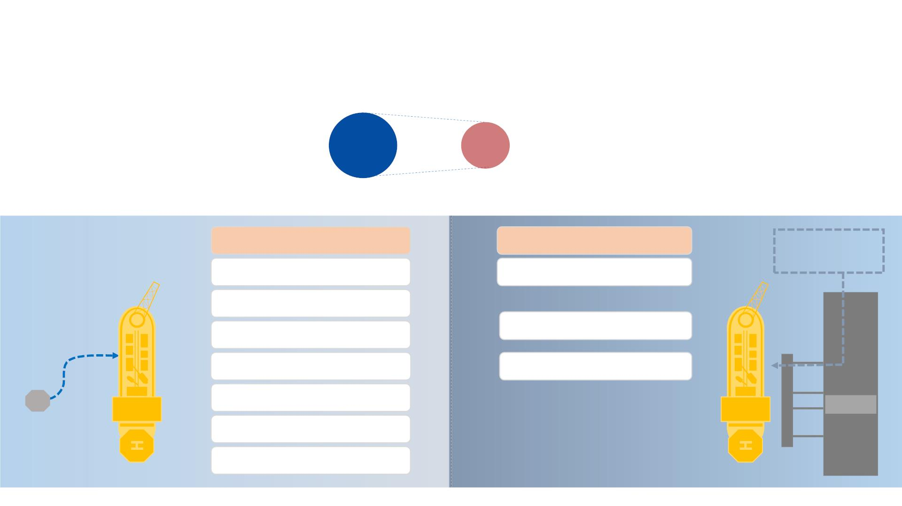
Preparing for Future FLNG
FLNG Solutions with SHI
[1st Generation] Well Gas “FLNG”
- Well-stream producer
100%
[2nd Generation] Pipeline Gas “Liquefier”
- Lower CAPEX /OPEX / Standardized Design
- Flexible Supply / Lower FID Thresholds
- Higher CAPEX / OPEX
$/TPA
50~
70%
Well-stream Gas
Pipeline Gas
Gas
from Pipeline
(with Condensate, Water)
(w/o Condensate)
Complicated Inlet
(Pressure, Temp. control)
Simple Inlet
Condensate Separation
Heavy Pre-Treatment
Liquefaction
Light Pre-Treatment
Multiple Liquefaction
Subsea Control
(MEG, Pig etc.)
Jetty
WELL
Condensate Storage
Turret

Slide 9
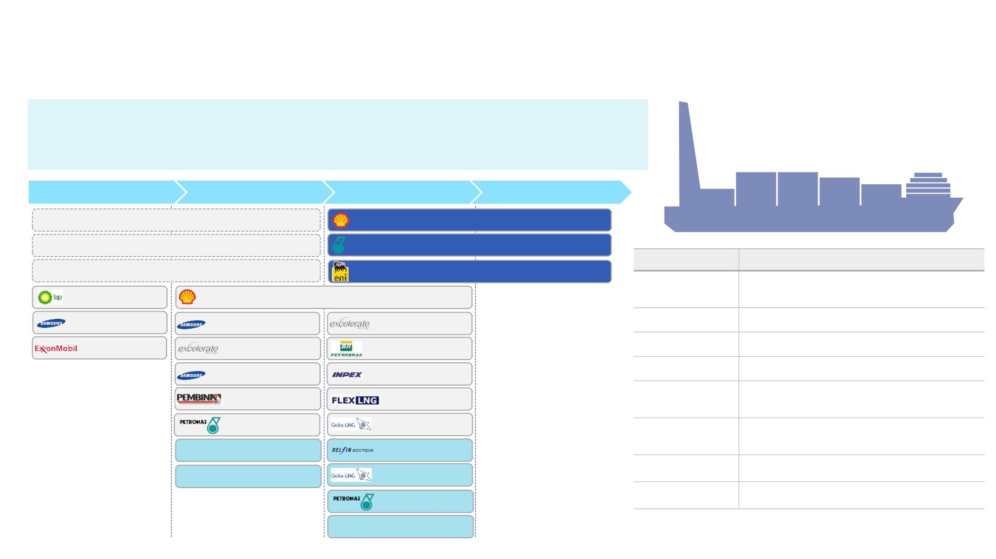
Preparing for Future FLNG
FLNG Solutions with SHI
“Comprehensive FLNG Solution available to Customer”
SHI have provided the best fit-to-purpose solution
Concept Study
Pre-FEED
FEED
EPC
(MTPA)
Shell Prelude FLNG (3.6)
Petronas FLNG Dua (1.5)
ENI Coral FLNG (3.3)
FLNG Spectrum in SHI
Item
Description
Field
Nearshore (Mild) to Offshore (Moderate /
Harsh)
Tortue 1B (3.0)
Shell Browse FLNG (4.0)
Lavaca bay (4.0)
PB FLNG (2.5)
SHI FLSO (2.0)
Liza FLNG (0.9)
Nearshore FLNG(3.0)
Triton FLNG(2.0)
AG FLNG(1.0)
Feed Gas
Raw and Treated Gas
Liquefaction
Cargo Capa.
SMR, DMR, N2, SENSE IV
INPEX Masela(2.5)
FLEX FLNG(2.0)
170K ~ 240K m³ (One or Two Row CCS)
Cedar FLNG(3.0)
Mooring
Turret, Jetty or Spread Mooring (incl. One-
Side Mooring)
Nearshore (2.0)
Golar FLNG(3.3)
Delfin GOM(3.5)
Golar FLNG(5.0)
MLA (Marine Loading Arm),
Flexible Hose
Offloading
Confidential Nearshore (6.0)
Confidential
Offshore (5.0)
Power
GTG, STG+DFGE, Onshore Power
Yes with Thrusters
Nearshore (2.0)
Self Propulsion
Confidential Nearshore (3.0)

Slide 10
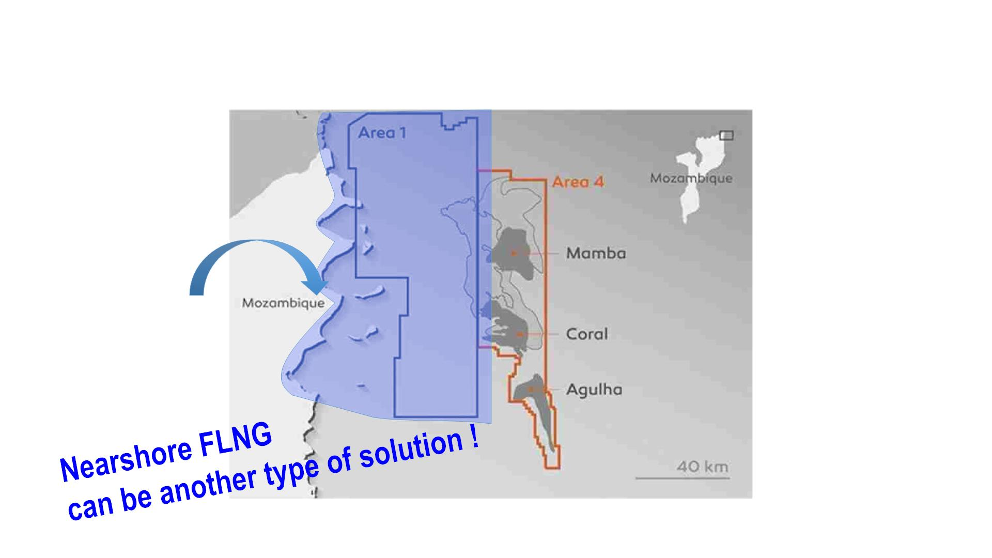
Preparing for Future FLNG
FLNG Solutions in Mozambique
§ Land Development
- Build up accommodation,
Power/utility supply units
and Jetty at only limited area
Existing solution
→ Offshore FLNG

Slide 11
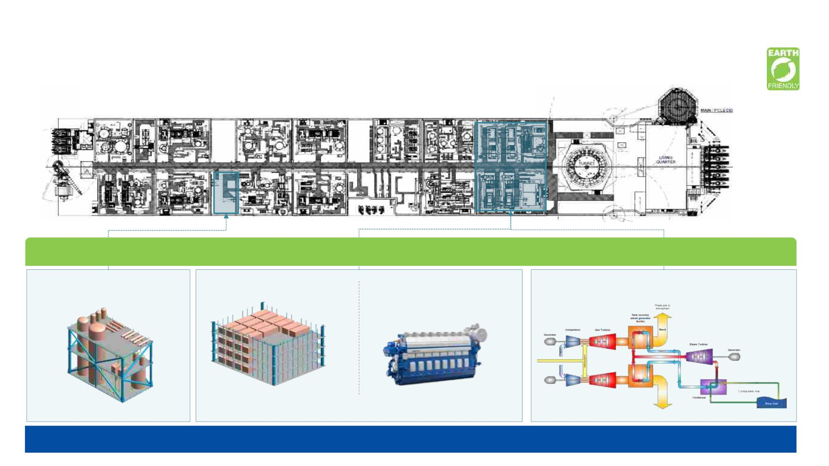
Preparing for Future FLNG
Greener Solution for Offshore FLNG
Higher efficiency, Lower emission Solution for FLNG
De-carbonization Solution
Carbon Capture
+ Well Injection
Fuel Cell Module
Dual Fuel
Generator Engine
Waste Heat Recovery Power Gen. /
Compressor drivers
CO₂ Capture Liquefaction & Storage
Less CO₂ emission Solution
Higher efficiency, Eco-Friendly
Goal : CO₂ Emission Reduction 30 ~ 45%

Slide 12
Summary
Solution Provider for FLNG
ü LNG demand and supply forecast envisages over 30% more LNG
facilities will be needed beyond 2030.
ü Nearshore FLNG can be Hybrid solution between Onshore LNG Plant
and Offshore FLNG
ü “Comprehensive FLNG Solution available to Customer”
SHI have provided the best fit-to-purpose solution
ü Offshore FLNG with carbon emissions controls and eco-friendly
technologies are ready for next frontiers.

Slide 13

Thank You

