Slide 1

The role of sovereign funds

Slide 2
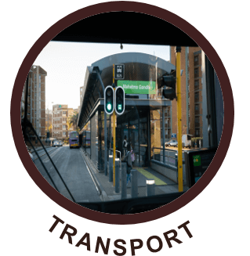





The role of governments?
Deliver value for the citizens

Slide 3
Introduction TO DBSA
Preparing, financing and implementing infrastructure projects in Africa
Founded 1983 DBSA Act 1997
Owned
100%
by SA Government
Total assets
R100bn
(US$6bn)
Equity R35bn
(US$2.6bn)
Externally rated
DBSA foreign currency rating is
Baa3 (Moody’s)
Well governed
Unqualified audits
A+ rating from AADFI PSGRS
Globally accredited
Global Environmental Facility
Green Climate Fund EU 6-pillar

Slide 4
Introduction
Preparing, financing and implementing infrastructure projects in sub-Saharan Africa
Mission
Strategic objectives
Advance development impact in Africa by expanding access to development finance and effectively integrating and implementing sustainable development solutions to:
Improve quality of life through the development of social infrastructure
Support economic growth through investment in economic infrastructure
Support regional integration
Promote sustainable use of scarce resources
Sustained growth in developmental impact – aggressively grow businesses to maximise developmental impact
Integrated infrastructure solutions provider across value chain – partner of choice
Financial sustainability – maintain profitability and operational efficiency to enable growth in equity and fund developmental activities
Sustainability innovations

Slide 5
Integrated approach to infrastructure development
1. Plan
2. Prepare
3. Finance
4. Build
5. Maintain
Municipal assessments
Bulk infrastructure plans
Infrastructure planning advice
Project identification
Feasibility assessments
Technical assistance
Programme development
Project preparation funds
Long-term senior and subordinated debt
Corporate and project finance
Mezzanine finance
Structured financing solutions
Managing design and construction of projects in education, health and housing sectors
Project management support
Supporting maintenance/ improvement of social infrastructure projects
Clients
Public
Municipalities
SOEs
Sovereigns
Private
PPPs
Private sector

Slide 6
VALUE CHAIN Financing
Development impact in areas of social and economic infrastructure
Instruments
Description
Bridging Finance
Bridging finance (BF) to assist with expediting grant funded projects or bridging proceeds of long-term loans. To be repaid within the same financial year
Conditional grants front loading – bridging of conditional grants over the MTREF (2-3 years)
Long-term Facilities
On-balance sheet debt – vanilla loans and bonds up to 30 years
Project (cash-flows backed) Finance
Sculpted and structured loans that match the expected project cash flows
Blended loans (tenor and interest rates) through:
International DFI credit lines,
Mobilising third party sector specific funds (e.g., GCF and GEF)
Credit Enhancement Securitisation Structure
Credit guarantees and first loss instruments
Subordinated (mezzanine) debt instruments
Catalysing of private sector (commercial banks and asset managers) funds by allowing private sector to take the shorter end with the DBSA taking the tail end of the deal

Slide 7

"The care for human life and happiness, and not their destruction, is the first and only object of good government"
Thomas Jefferson

Slide 8
THANK YOU

