Slide 1
GLOBAL OPPORTUNITIES FOR MOZAMBIQUE’S GAS
Imran Mohammed
Gas Transportation and Storage Analyst,
Gas Market Analysis Department
Gas Exporting Countries Forum
Mozambique Gas and Energy Summit
September 14 2022

Slide 2
DISCLAIMER The data, forecasts, analysis, and/or any other information contained within this document and any attachments thereto (“Documents”) are for information purposes only and are provided on a non-reliance basis and any obligation and responsibility is hereby disclaimed with respect to such content. Neither the GECF, any of the GECF Members and Observer Countries, nor any of their officials, representatives, agents or employees (the ‘Parties’), while fully reserving their rights with respect thereto, shall assume any liability or responsibility for the content of the Documents and any data, analysis, or any other information incorporated therein None of the Parties, including any individual involved in the preparation of the Documents, provides any representation or warranty, express or implied, nor assumes any liability or responsibility as to the accuracy, adequacy, completeness, or reasonableness of any material, information, data or analysis contained in the Documents or represents in any way that its use would not infringe any rights owned by a Party or any third party. The Parties shall not be liable for any errors in, or omissions from, such information and materials. The Documents is not intended nor shall it be deemed as a substitute for your own independent judgment or professional advice for your business, investment, finance, or other commercial or non- commercial activity or clients. Subject to the above reservation, the analysis, information and views presented in this Documents are those of the GECF Secretariat and do not necessarily reflect the views of GECF Members and/or Observer Countries. Except where otherwise stated expressly, the copyright and all other intellectual property rights in the contents of this Documents (including, but not limited to, designs, texts, and layout) shall be the property of GECF. As such, they may not be reproduced, transmitted, or altered, in any way whatsoever, without the express prior written permission of the GECF. Where the Documents contain references to materials from third parties, the GECF Secretariat shall not be responsible for any unauthorized use of third party materials and/or the consequences of such use.

Slide 3
1
About the gecf

Slide 4
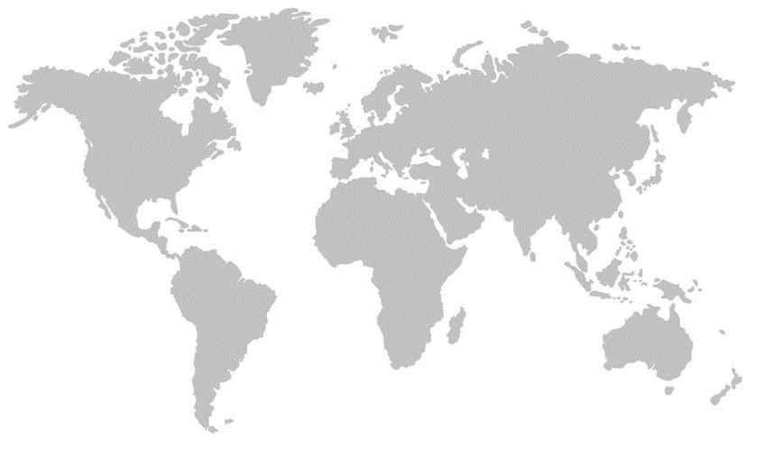
About the Gas Exporting Countries Forum (GECF)
MEMBERS
OBSERVERS
Algeria
Angola
Bolivia
Azerbaijan
Egypt
Iraq
Equatorial Guinea
Malaysia
Iran
Mozambique
Libya
Norway
Nigeria
Peru
Qatar
United Arab Emirates
Russia
Trinidad and Tobago
Venezuela
Proven Natural Gas Reserves
Marketed Gas Production
Pipeline Gas Exports
LNG Exports

Slide 5
About the Gas Exporting Countries Forum (GECF)
Natural gas for sustainable development
Promote fair value of natural gas
Enhance cooperation among Member Countries
Platform for consumer-producer dialogue
Flagship events such as annual workshops, Gas Lecture series, as well as seminars with leading industry players
Collaboration with intergovernmental organisations such as the UN and G20, as well as similar energy-related institutions such as OPEC and JODI
Gas Research Institute provides an arena for cooperation in areas such as scientific and technological research

Slide 6
2
Global context

Slide 7
Supply and Demand
Global Gas Consumption by Region
Global gas consumption has been increasing annually
Key drivers in 2021: Global economic recovery, as well as abnormal weather conditions, with a very cold winter and a warm summer
Major growth in the Asia/Oceania market
Going Forward: Continued growth, but at a slower rate
Source: GECF Secretariat based on data from BP Statistical Review 2021, Cedigaz and IEA Monthly Gas Statistics

Slide 8
Supply and Demand
Global Gas Production by Region
Average annual growth rate of 2% between 2010 and 2020
North America, CIS, and the Middle East had the highest production
Africa, CIS, and the Asia Pacific regions were the dominant sources of production growth
Going Forward: Sustained growth, which may be hampered by financial restrictions in the high inflation environment
Source: GECF Secretariat based on data from Cedigaz, and BP Statistical Review
(*) GECF’s forecast for 2022 and 2023

Slide 9
LNG Trade, New Projects and FIDs
Global LNG Trade by Region
FIDs on New Liquefaction Capacity
Source: GECF Secretariat based on data from ICIS LNG Edge
(*): GECF Secretariat’s forecast for 2022 and 2023
Source: GECF Secretariat based on data from Argus, ICIS LNG Edge, Refinitv and Project Updates
(*): Projects targeting FID

Slide 10
Prices and Contracting
Gas, LNG and Oil Spot/Future Prices
LNG ACQ by Contract Duration
Source: GECF Secretariat based on data from Argus, Refinitiv and OANDA
Note: Oil-indexed 1: 14.85% X Brent (6-0-1) + 0.5; Oil-indexed 2: 10.87% X Brent (3-0-1) + 0.5;
Source: GECF Secretariat based on data from Wood Mackenzie
(*): January to May 2022

Slide 11
3
Opportunities for Mozambique lng exports

Slide 12
Opportunities for Mozambique LNG Exports
Estimated Spot LNG Shipping Cost
Potential to target the Asian region:
Established markets: China, Japan, India
Emerging/newer markets: Pakistan and Bangladesh
Geographical location presents cost advantages for Mozambique’s projects in key Asian markets
Source: GECF Secretariat based on data from Argus and ICIS
Model Assumptions: Spot LNG prices and spot charter rates for steam turbine carriers, for August 2022

Slide 13
Concluding Remarks
Natural gas will continue to play a pivotal role in the energy transition
Supply- and demand-side factors will encourage sustained growth in both gas consumption and production
In recent times, prices in the global gas markets are subjected to record highs and extreme volatility as a result of geopolitical drivers and the post-pandemic recovery
LNG importing countries have tended towards long-term supply contracts to secure their energy supply
Mozambique’s LNG export projects are favourably poised to take advantage of the current high-price, high-demand gas market
In particular, the geographical location of Mozambique’s projects offer great potential for markets in the Asian region

Slide 14
Thank you for your kind attention

