Slide 1
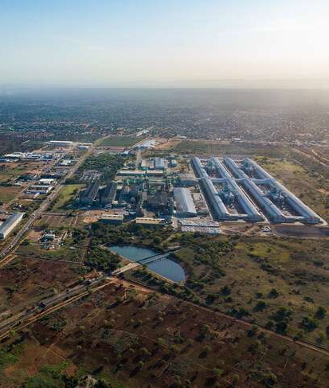



Eco Agro-industrial Parks Development in Mozambique
Special Economic Zones
Mozambique Gas & Energy Summit & Exhibition
15 September 2022

Slide 2
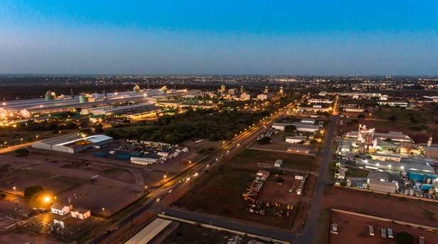

Welcome
to MozParks.

Slide 3
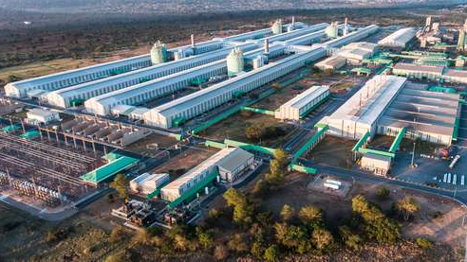
Home to Mozal: the second biggest aluminum smelter in Africa
Home to CTB: 2000 MW power Gas Station

Slide 4

60%
Private
MozParks is the national developer and manager of:
Industrial Parks
Industrial Parks
Agro Parks
Industrial Free Zones
WHO WE ARE
Special Economic Zones Zones
PUBLIC PRIVATE PARTNERSHIP
40%
Government

Slide 5
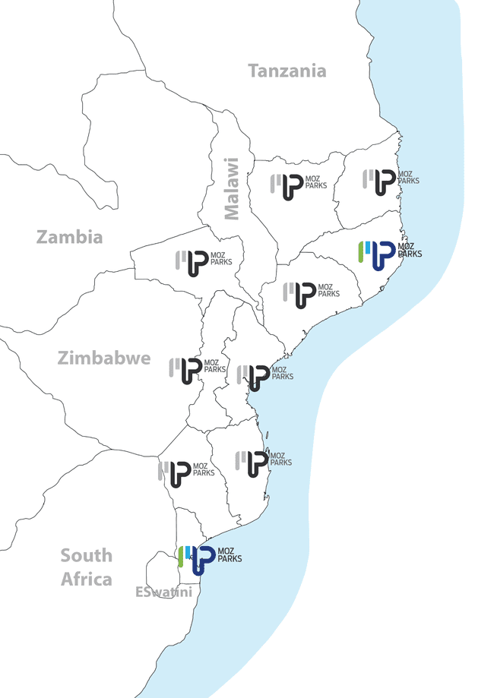
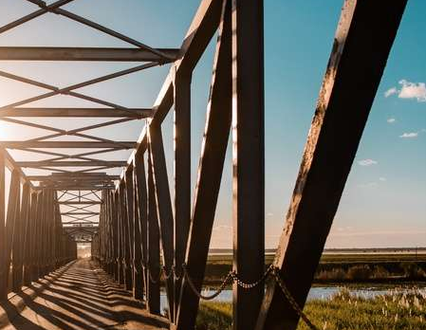
Our goal
Our goal is to establish at least one MozPark in each province of Mozambique by 2030.

Slide 6
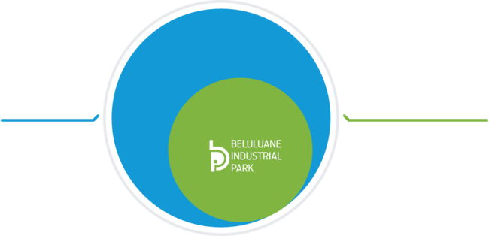
Key achievements
700
Hectares available with 300 hectares already developed
+ 17
Countries represented
Over
USD 3 billion
+ 50
Companies in
Beluluane Industrial Park
FTZ
Companies in
free-trade zone qualify for tax exemptions and fiscal incentives
+ 8000
Job created

Slide 7
Why establish your company in Mozambique - MozParks?
Tax incentives by the Government
Complete investor solutions
Industrial Land: Access to roads, electricity, water and others…
Better urban planning and zoning
Strategic location (logistics)
Better business environment
Linkage programs
Better access to qualified labor
Circular economies
Economies of scales
Opportunities for local communities

Slide 8
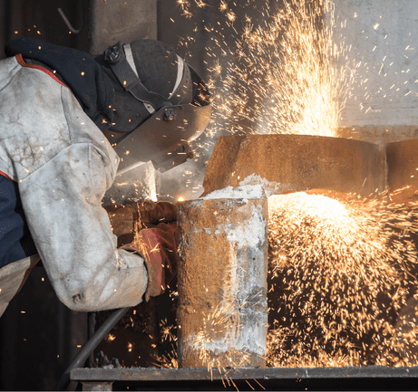
Business opportunities in MozParks
Downstream (Aluminum
titanium ore…)
Renewable energy
Construction material
Glass products
Packages
Beauty Products
Ceramics
Agro -Processing
Recycling
IT
Maintenance and Service providers
Skills Development & Training

Slide 9
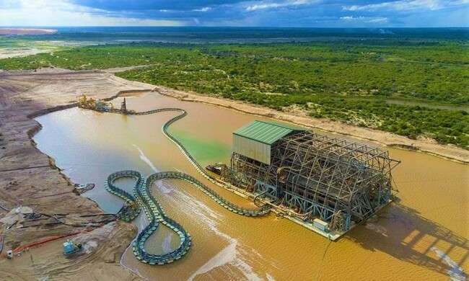


Kenmare mining project

Slide 10
200ha in total
30ha underdevelopment
Investment
Topuito Special Economic Zone
By MozParks
Pled (World Bank Facility) Support
Support local content development
Kenmare
One of world’s largest mineral sand producer
Most transparent extractive Industry in Mozambique
Attract Kenmare Mine Suppliers
Strong focus on Agro value chain
Market: Catering Companies
Partner
Government of the Nampula province

Slide 11
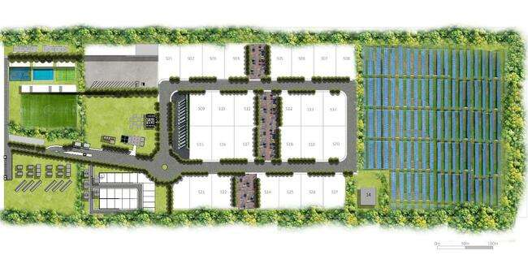
The Mozambican Way
16
11
14
THE SEZ MODEL
30ha
10
2
Common areas
Renewable energy
9
13
14
1
3
7
Entrance
5
6
8
17
4
14
12
15
Commercial area
Sports area
Bus Stop
Residential area
One stop shop
Security
Park offices
Training centre
Food court and restauration area
Common ablutions
Warehouses
SME village
Truck and car Parking
Parking spaces
Waste Square
Market and exhibition
Renewable energy
S01-27 Industrial Plots

Slide 12
PHOTO GALLERY

Slide 13
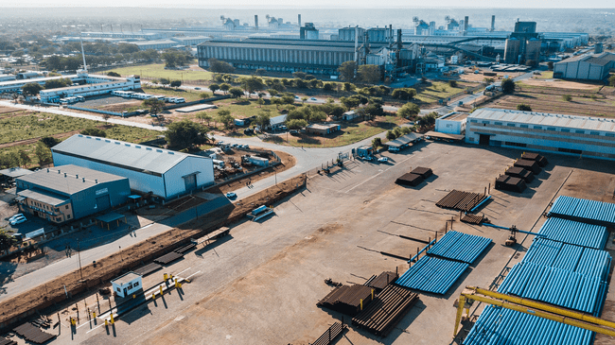

Slide 14
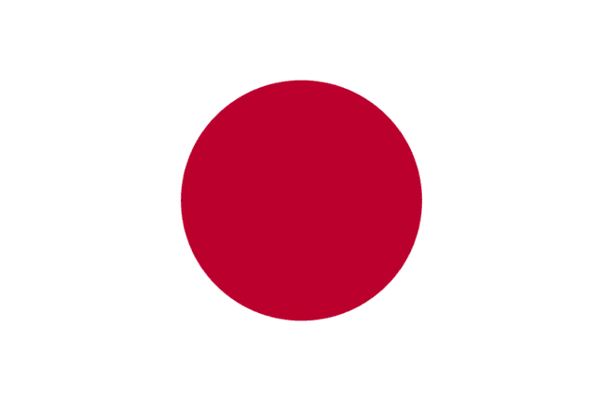


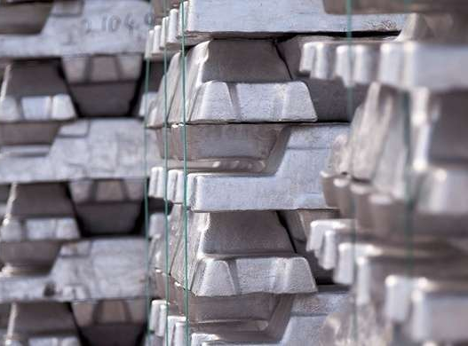
Mozal Aluminum.
Anchor project of the park
South32 is the major shareholder
In operation since 2000
Contributing for 40% to the GDP of the processing industry

Slide 15


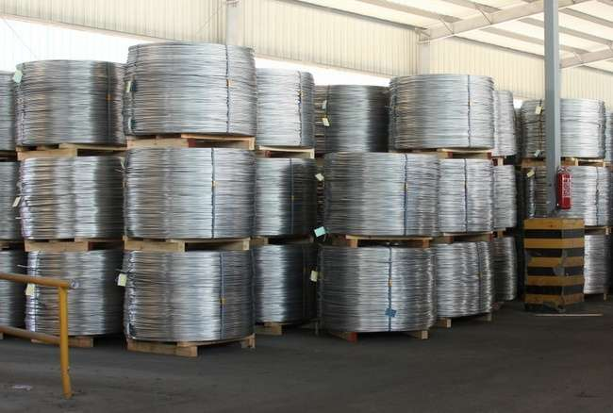
Midal Cables International.
Aluminium and alloy rod manufacturer
Wire and conductor manufacturer
50 000MT capacity

Slide 16
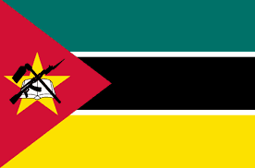
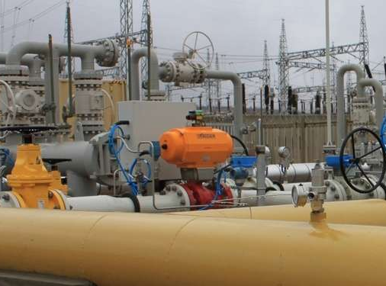
Matola Gas Company (MGC)
200 MW supplied to gas fired power plants located in Ressano Garcia and Maputo
In 2013, MGC became the second largest natural gas company in Southern Africa supplying gas to over 30 industries, public transport and several power stations

Slide 17

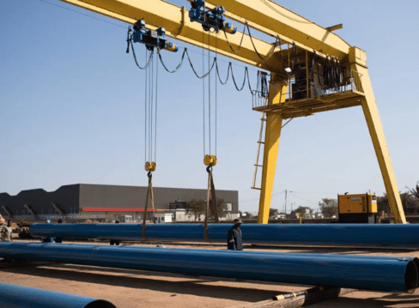
Capital Star Steel.
Steel pipe manufacturer
2nd Largest Steel Pipe Manufacturing Plant in Africa
Lionsteel-subsidiary
Serving Gas & Mining
200 000 tons per annum production capacity

Slide 18

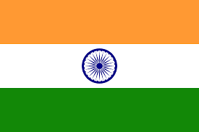
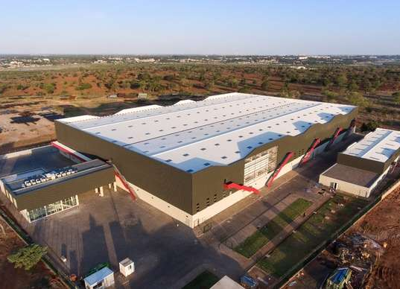

Godrej Group.
Largest manufacturer of artificial hair (Darling)
3300 employees
75% of employees are women

Slide 19


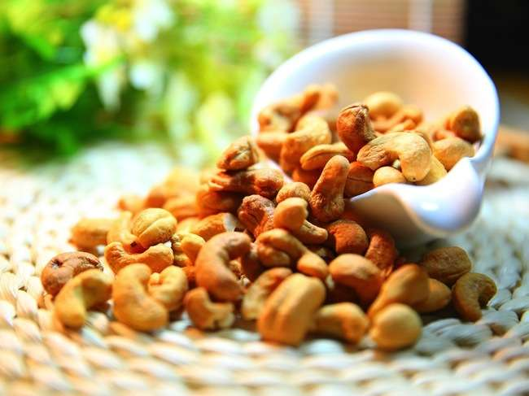
Sunshine Nut.

Slide 20
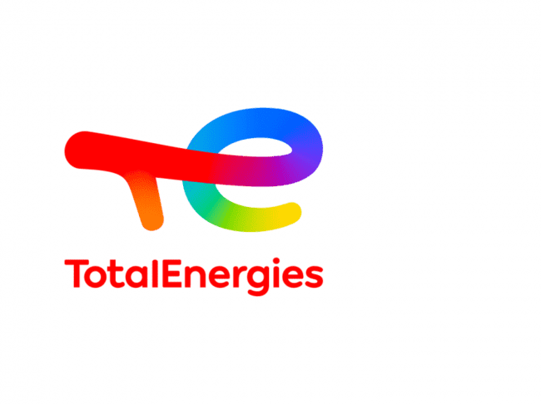
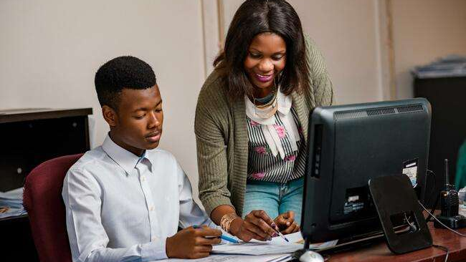
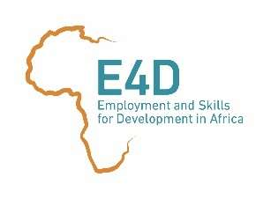





Youth Employment
Programme

Slide 21
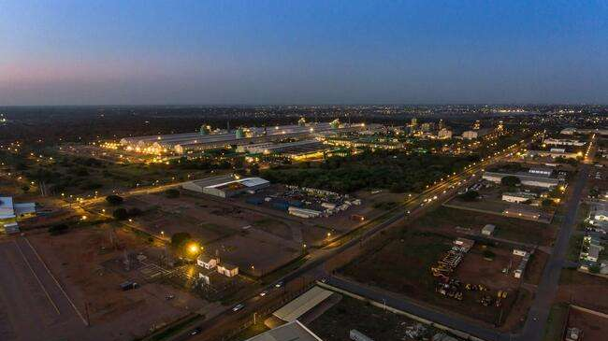

THANK YOU
CONTACTS
MozParks General Director
Onorio Manuel
onorio.manuel@mozparks.co.mz
+258 84 210 8 210

